Slide 1
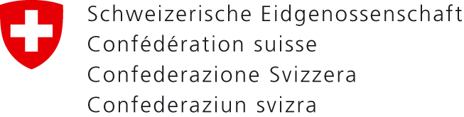

RDA
Cooperation in the Cultural and Heritage Sector
First approaches in the German-speaking countries
Département fédéral de l'intérieur DFI
Office fédéral de la culture OFC
Bibliothèque nationale suisse BN
Christian Aliverti (Swiss National Library)
Renate Behrens (German National Library)
RDA in the Wider World, IFLA Satellite Meeting
Dublin, OH, USA, 11 August 2016

Slide 2
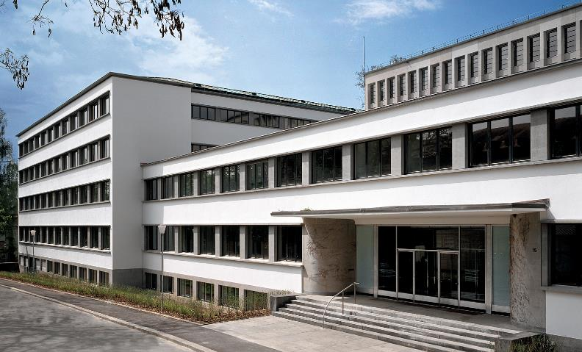
Notes:
Christian
Christian Aliverti, Head of the Section of Bibliographic Access at the Swiss National Library, Librarian. Member of the Management Board of the Swiss National Library, Head of the Section of Bibliographic Access which includes the subdivisions Cataloguing, Subject Indexing and the Bibliography on Swiss History. In charge of the cataloguing principles of the Swiss National Library. Member of the Committee for Library Standards and EURIG representation for the Swiss National Library. Lecturer at the University of Zurich and at the University of Applied Sciences HTW Chur.

Slide 3
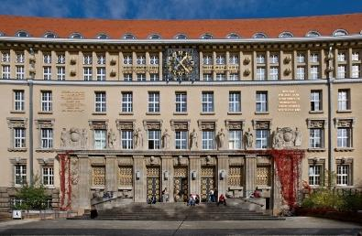
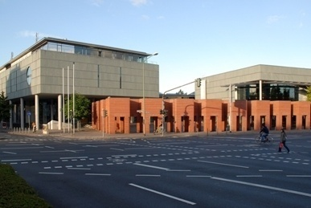
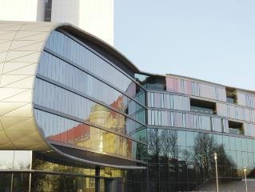
Notes:
Renate
Renate Behrens, Head of RDA-Project in Austria, Germany and German-speaking Switzerland, Librarian, since many years in different fields in the German National Library, since 2008 in the Office for Library Standards, Head of the RDA-Project in Austria, Germany and German-speaking Switzerland, EURIG representation for the German National Library, member of the IFLA Cataloguing Section, European Regional Representative to the RDA Steering Committee (RSC)
The German National Library, founded in 1912, has two sites, one in Leipzig and one in Frankfurt. We are collecting publications from and about Germany including electronic and web-publications.
We have special collections as the German Museum for books and writing, the archive of the German exile and the German Music Archive. So we have been concerned with special materials right from the start of the implementation project.

Slide 4
Contents
Cataloguing codes in the German-speaking countries
Translation into German
International cooperation
Implementation of RDA
Special and rare materials
Role of authority data
Collaboration with cultural institutions
Conclusion
Notes:
Christian

Slide 5
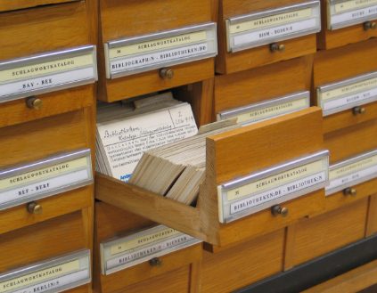
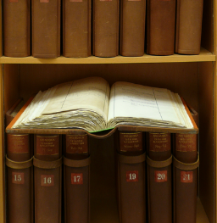
Cataloguing Codes in the German-speaking Countries
1899, Instructions for the alphabetical catalogues of the Prussian libraries
1970, RAK, Rules for descriptive cataloguing
1980, RSWK, Rules for subject cataloguing
2016, RDA for bibliographic and authority data
Notes:
Christian
The "Instruktionen für die alphabetischen Kataloge der preussischen Bibliotheken und für den preussischen Gesamtkatalog" ("Instructions for the alphabetical catalogues of the Prussian libraries and for the complete Prussian catalogue") was published in 1899 by the Royal Prussian Library as the first bibliographic cataloguing code to claim validity for the entire German-speaking area.
The development of the rules for descriptive cataloguing (RAK - "Regeln für die alphabetische Katalogisierung”) in the 1970s represented the systematic start of modern cataloguing based on electronic data processing, aimed at facilitating the exchange and re-use of the data. A new aspect of this code was its user-orientation and the separation into basic and special rules. Here a distinction was made between use in academic and public libraries, and separate editions were published for special areas, e.g. "RAK-Musik".
The rules for subject cataloguing (RSWK - "Regeln für den Schlagwortkatalog") developed in the 1980s for subject indexing emphasised the importance of labour division and cooperation as a means of improving the library services. This solution was then subsequently pursued by libraries and library networks for the German-speaking countries.

Slide 6
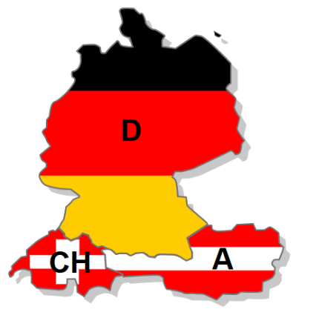
Committee for Library Standards
National Libraries
Library Networks
Special Libraries
Public Libraries
Notes:
Christian
Cultural policy in the German-speaking countries is heterogeneous in nature, which should be taken into consideration when analysing the situation in the libraries. We have national libraries, library networks, special and public libraries. All institutions are under different responsabilities, may be on federal, state, cantonal and even municipal level.

Slide 7
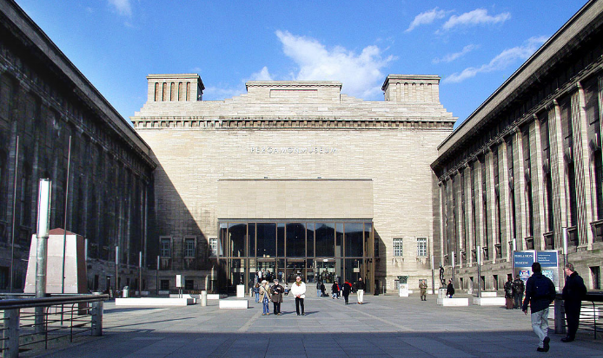
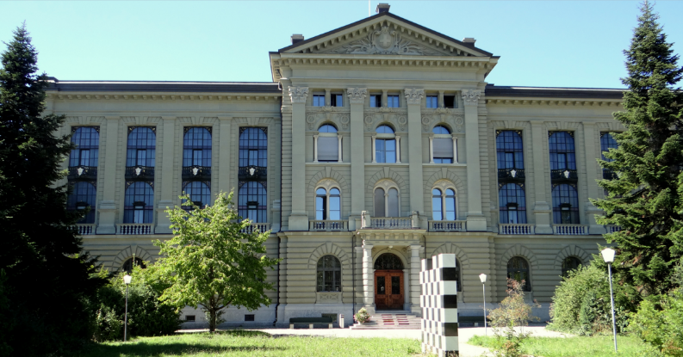
Organisational Structure for Museums and Archives?
Notes:
Christian
The situation in the library sector in the German-speaking countries is not at all comparable for archives and museums. There is no organisational structure to build up a common project and there is no tradition for common rules or standards. In the museum community especially, nearly every institution is working with its own rules or standards to describe its collections.
Pergamon Museum, Berlin
Schweizerisches Bundesarchiv, Bern

Slide 8
RDA in the German-speaking library community
Implementation in three steps
Translation
International Cooperation
RDA Project
Notes:
Renate

Slide 9
Translation
2004 decision of the Committee for Library Standards
to engage in a German translation
2012 first German translation of RDA on the website
of the German National Library
2013 the German translation is available in the
RDA Toolkit
2015 French translation of the D-A-CH policy statements
Continuous updating of the German translation
Notes:
Renate
The introduction of RDA in the German-speaking area was the first time that the standard RDA was implemented in a non-Anglo-American linguistic and cultural environment. A key precondition for using the cataloguing code was having the RDA standard available both in English and in a German translation. When it was decided to change to the new cataloguing code it was also resolved to make the work environment available in German. The Office for Library Standards at the DNB was tasked with preparing an authorised translation of the code text into German.
At the end of November 2012 the German translation of the RDA cataloguing code text was made available free of charge on the DNB's website for one year in the form of PDF files and the German text and a German user interface were made available in mid-May 2013 in the RDA Toolkit.
During the project period, the working group RDA in the German-speaking countries reviewed the German version permanently for its suitability and corrected the text or added examples if necessary.
In 2015, the Library Network of German-speaking Switzerland provided a French translation of the D-A-CH policy statements.
D-A-CH is the acronym of Germany, Austria and Switzerland. It is commonly used to designate these German speaking countries.

Slide 10
International Cooperation
D
A
CH
EURIG
RSC
RDA Steering Committee
EURIG
Editorial
Committee
Europe
European Regional Representative
Notes:
Renate
The work process in the RDA project is informed at the technical level by input from various international bodies. Worthy of mention here is the work produced by the IFLA Cataloguing Section, the RDA Steering Committee (RSC) and the European RDA Interest Group (EURIG). Cooperation-based and consensus-oriented work is the key to success, although this involves reconciling a number of highly distinct approaches in the different cultures.
The German National Library is a member of the RSC since 2012; there it has represented the interests of the library community in the German-speaking countries over the past years. Since 2016, due to the new strategic organisation of the RSC and the RDA Board, the German National Library provides the European Regional Representative to the RSC.
http://www.ifla.org/cataloguing
http://www.rda-rsc.org
http://www.slainte.org.uk/eurig/index.htm

Slide 11
RDA project : an overview
2012, start of the RDA Project in D-A-CH
2014, policy statements in the RDA Toolkit
2014, implementation of RDA in the
Integrated Authority File (GND)
2015, consortial license for the RDA Toolkit
2015/2016, RDA Training
2016, all partners of the RDA Project have switched to RDA
2016, at the end of the year the RDA Project ends
Notes:
Renate
Following the decision of the Committee for Library Standards, the cooperative RDA project started in summer 2012. In the next three years many working groups and sub working groups started up their work. The main objective of this work was a cooperative approach of all partners to ensure and maintain the traditional and broad exchange of metadata after the implementation of RDA.
As a first step RDA has been implemented for the Integrated Authority file (GND) in mid 2015. Training sessions were provided in the months before in all partner institutions.
For descriptive cataloguing, the RDA working group worked out the policy statement for the implementation in the D-A-CH community. The policy statement is accessible in the RDA Toolkit since summer 2014. Furthermore, a standard set of elements including RDA core elements and additional elements has been worked out and was defined as a mandatory element set. In a last step the three national libraries completed the standard set of elements with additional agreements for national libraries. All working documents are accessible in a free wiki space RDA-Info-Wiki.
From September 2015 until the end of the year a big part of the library community in Austria, Germany and German-speaking Switzerland went to school. The starting basis for these lessons were the training materials worked out in a cooperate process from all project partners. The training materials are available at a public wiki space. Before starting the training, all institutions instructed RDA trainers. For instance, in the German National Library 35 colleagues started in summer 2015 to work with the training materials, prepared teaching sessions and got additional didactical and methodical support.
In a transition period from October 2015 until January 2016, all 16 partners of the RDA project switched to RDA. Institutions from outside the project now begin to start with the implementation process and are supported by the German National Library especially in the range of RDA training.
An essential element of the work with RDA is the RDA Toolkit. Therefore a consortial licence for all libraries and other cultural institutions in Germany, Austria and Switzerland is provided. It applies for all institutions in the three countries but also for institutions from beyond D-A-CH with head offices in D-A-CH (e.g. Goethe-Institut) but does not apply for commercial institutions. The German National Library is the consortium leader and manager.
https://wiki.dnb.de/display/RDAINFO/RDA
https://wiki.dnb.de/display/RDAINFO/Schulungen

Slide 12


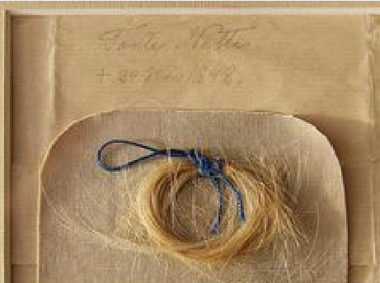
What about Hair-locks?
RDA ???
Notes:
Renate
Already in the first implementation phase from 2012 to 2015 the German-speaking community had a focus on special and rare materials and tried to start cooperation with archives and museums. A joint working group between libraries and literary archives started in 2014. This first step has been very difficult and a bit frustrating.
It seems to be nearly impossible to cover so much different types of resources under one standard. But what types of resource we are talking about when we talk about archival resources and materials from museums?

Slide 13
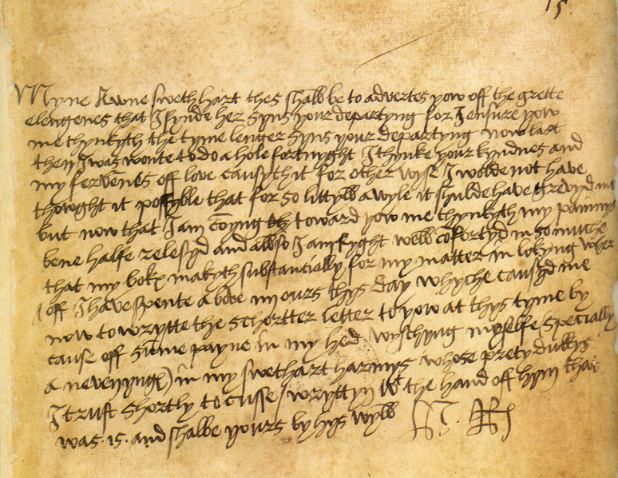
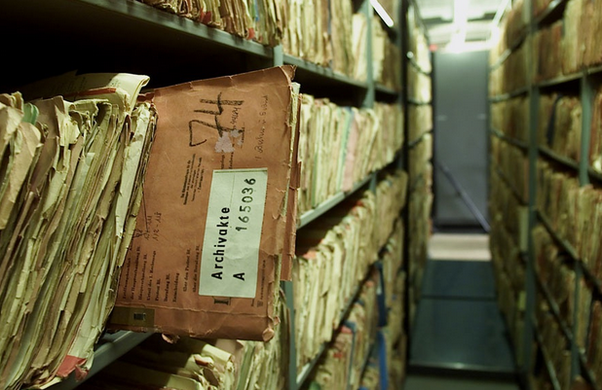
Letters, dossiers
Notes:
Renate
Archival materials: letters, files, dossiers
Autograph letter of king Henry VIII of England to Anne Boleyn

Slide 14
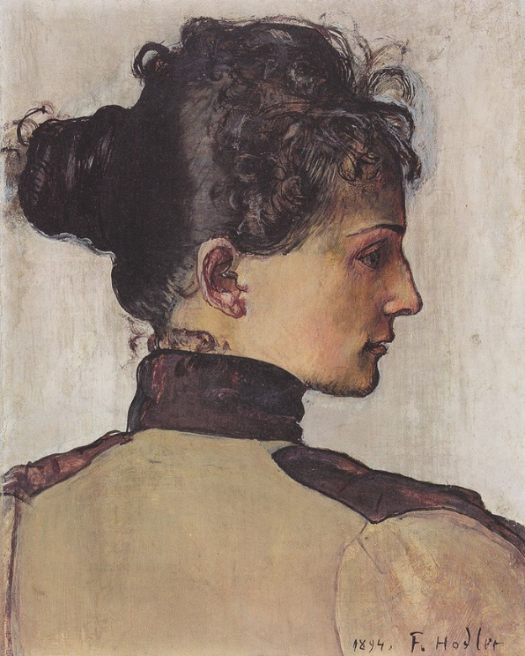
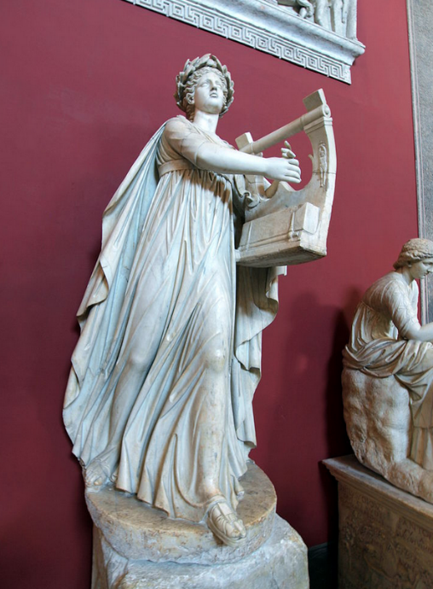
Objects and Paintings
Notes:
Renate
Objects and Paintings
Vatikanische Museen
Ferdinand Hodler

Slide 15
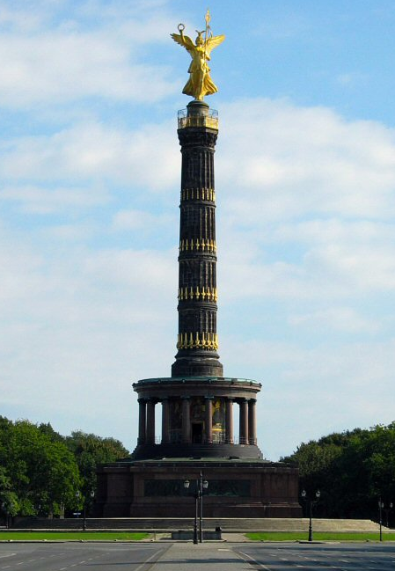
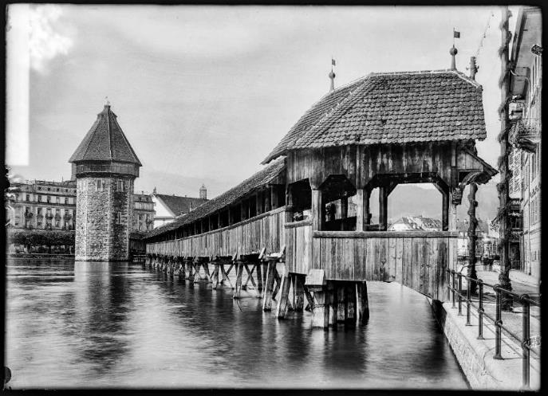
Buildings
Notes:
Renate
Buildings
Kapellbrücke Luzern
Siegessäule Berlin

Slide 16
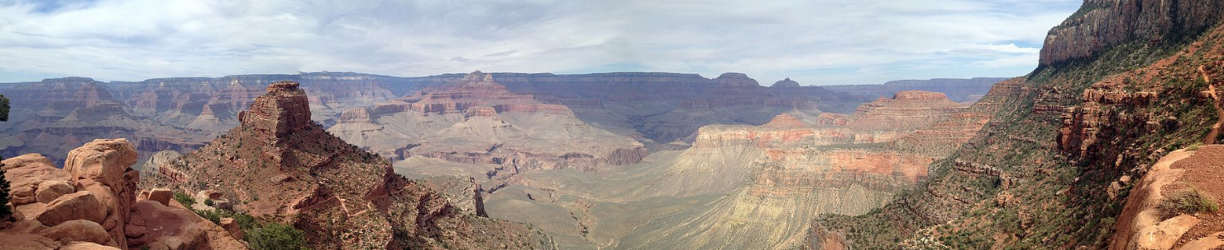
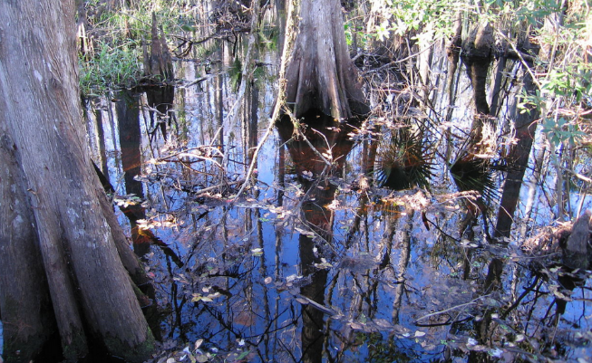
Natural Monuments
Notes:
Renate
Natural monuments
Grand Canyon
Everglades

Slide 17
Paintings
RDA Toolkit
Objects
Buildings
RDA Toolkit
Monuments
Dossiers
Letters
etc.
Notes:
Christian
Does it make sense to provide all the rules for such materials in the RDA Toolkit itself?
For the German-speaking countries we are trying another approach. We think, that the alignment of existing and well-established standards from the wider community as archives and museums to RDA would be a better way. The goal of the alignments is not to bring all the existing rules into the RDA Toolkit. This approach means to continue to use other standards than RDA too and to make them compatible and interoperable with RDA. The full integration of all special rules would inflate the RDA Toolkit. So the better way would be cross-references between RDA and the guidelines and standards of other communities to cover the needs of non-library communities.
Here an example for such an alignment.

Slide 18
RNA/RDA an Example
RNA
RDA
RNA
RDA
Notes:
Christian
In the German-speaking community literary archives work with the Rules for Literary Estates and Autographs Rules (RNA). The RNA are optimized for the need of literary archives in the German language context to describe the estates and the personal papers of authors. The standard is easy to use even for untrained staff and there is a strong need to keep the current RNA standard in the same way. Therefore a complete merge of the RNA into RDA is not expedient.
The guidelines of the literary archives should be interoperable with RDA and any contradiction to RDA should be avoided. The access points are constructed according to RDA guidelines and according to the rules of the Integrated Authority File (GND). As a first step, the working group makes a complete review of the standard RNA and eliminates all rules which are already provided in RDA. Those rules which are not covered by RDA will remain in the RNA and a link will be made to them from the RDA Toolkit.
In general the main objective of all working groups for special materials is not a full integration of special rules. Quite the contrary: a full integration would inflate the RDA Toolkit and the better way would be cross-references between the RDA Toolkit and the guidelines and rules of other communities to cover the needs of cataloguers.

Slide 19
RDA
Committee for Library Standards D-A-CH
Application Profiles
EG
WG Literary Estates
D-A-CH
EG
WG Old Books
LC PCC PS
WG Graphic Materials
Best Practises MLA
WGs
WG Manuscripts
Literary Estates 2018 ff
WG Subject Cataloguing
Subject Cataloguing 2017/18 ff
Notes:
Christian
A second aspect beyond the content issues of this working group RNA/RDA is the organizational structure of such working groups for special resources. All working groups in the implementation project are expert groups from libraries. The members of the Committee of Library Standards has the the role of principals. With the working groups for special materials, further principals were taken on board. For the working group of the literary archives, as a pilot project in this context, the Koop Litera an association of literary archives in German-speaking countries is the partner of the Committee for Library Standards. This extended organizational structure allows a broader range of expertise and is a guarantee for the pursued acceptance of the standardization in this environment.
http://kalliope-verbund.info/_Resources/Persistent/442a360d0a1961bcd8843150f2bca0a15996581e/RNA-R2015-20151013.pdf
https://www.onb.ac.at/koop-litera/
... what are the current plans of the German-speaking community in this context.
The Committee for Library Standards has meanwhile defined this organizational structure and the work out of alignments from standards with RDA in its regulations and the working groups for special materials as a permanent component. At the moment we have the working group ….
We hope we can provide the results of this alignments as application profiles in the RDA Toolkit in the next years.

Slide 20
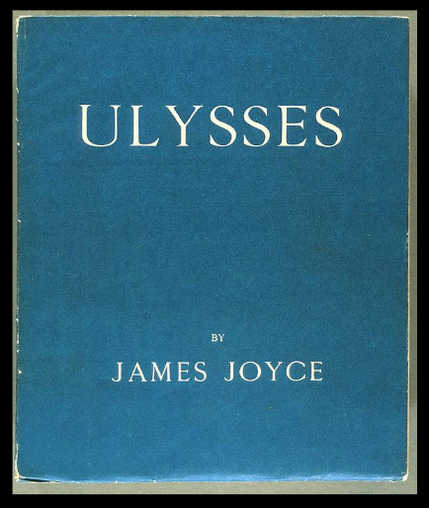
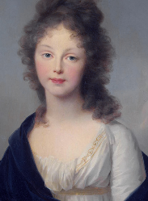
Cooperation?
Museums, Archives
Libraries
Notes:
Christian
Coming back to our fundamental question. The approach to elaborate alignments for special materials in several working groups seems to be a good approach. But what does the integration of other communities in the environment of RDA furthermore mean?
Our experience is: Archives, museums, digital humanities and others do not contact us librarians. They maintain their own standards, for example CIDOC CRM, International Standard Archival Descripiton ISAD(G) or even non standardised selfmade rules. We, the librarians have to contact them.
Talking with metadata specialists from other cultural organisations, like archives, we often notice that our colleagues think the librarians want to take over archival standards. They think RDA claims the lead in the metadata world.
That’s why we had several discussions sessions to clarify the question and to point out what other cultural institutions beyond the library community need for a collaboration as partners.

Slide 21


Cooperation!
Libraries
Museums, Archives
Notes:
Christian
So we have to start a real discussion:
Do they want collaboration with libraries?
Do we have the same goals?
What organisation do we need?
What are the benefits of a cooperation?
Who can be strong partners in this cooperation?
What can be a common starting point?
In the German-speaking community the discussion has started.

Slide 22
Authority Data have a high value and can be a common starting point for a cooperation with institutions providing cultural heritage.
Notes:
Christian
When we think about cooperation between cultural institutions and their metadata management, we have to talk about authority data. There are already several well established partnerships between very different players in this field. The links between the catalogues of the German or the Swiss National Library and Wikipedia is a good example of how it works.
Cooperation in the cultural sector means working together for a common benefit: a cost-effective production of metadata and consistent data for the benefit of the users. Therefore, it is important that access points are controlled by the same authority file. Rules and guidelines that are coming into line with RDA accept the RDA rules concerning access points and authority data the best. The reuse of the RDA access points in every cultural database makes it possible to link a library catalogue with other heritage databases. The use of the identifiers of the authority records is the most reliable way to link over different databases. The string (sequence of characters which are the name of the entity) is less important than the unique identifier which defines the entity described in the authority record. Thus, guidelines for constructing identifiers become more important than rules for describing names. So we can say that authority data is actually the most efficient linking point between databases of libraries, archives, museums, digital humanities, cultural heritage etc.
In the cataloguing tradition in the German-speaking countries authority data and authority control are important. In the catalogues authority data bring together what belongs together, separate what does not belong together, and identify the entity described in the authority record.
The Integrated Authority File (Gemeinsame Normdatei GND) is an authority file for names of persons, corporate bodies, conferences, events, places, topics and works. The descriptive catalogues and the subject catalogues in the German speaking area use the GND as their authority file. The authority records of the GND control the access points of the bibliographic records in our databases. The cataloguing code for the GND authority file obeys RDA for the entities which are used for descriptive and subject cataloguing, such as persons. For the entities which are only used for subject cataloguing, such as topics, the GND follows the “Regeln für den Schlagwortkatalog” (RSWK) which means Rules for the Subject Catalogue.

Slide 23
GND (Integrated Authority File)
GND Authority file for persons, corporate bodies, conferences and events, geographic entities (places), topics and works
Used for descpritive and subject cataloguing
Cooperation of 16 partners in three countries (extension is planned)
Cataloguing Codes
  RDA (since July 2014)
  RSWK (German rules for subject cataloguing)
Notes:
Renate
The GND is a cooperation of 16 partners in Austria, Switzerland and Germany hosted at the German National Library. Among them are National Libraries, State Libraries, Library Consortia, representatives from public or special libraries and a representative from the Standing Conference of the Ministers of Education and Cultural Affairs of the Länder in the Federal Republic of Germany.
The Integrated Authority File (GND) is an authority file for names of persons, corporate bodies, conferences and events, places, topics and works.
The descripitve catalogues and the subject catalogues in the German speaking area use the GND as authority file.
The cataloguing code for the GND authority file obeys "Resource Description and Access" (RDA) for the entities which are used for descriptive and subject cataloguing such as persons. For the entities which are only used for subject cataloguing, such as topics, we follow the RSWK, the German rules for the subject catalogue. By the way, it would be helpful to have rules for subject cataloguing also in the RDA toolkit.

Slide 24
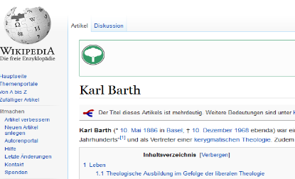
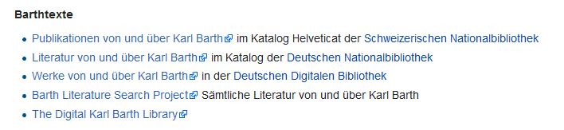
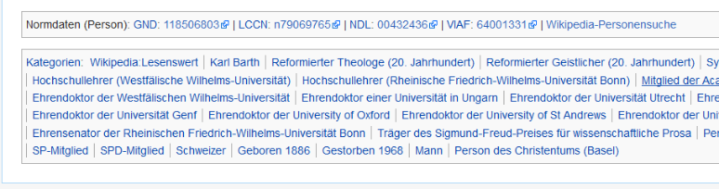
Wikipedia
Notes:
en
Renate
Here an example for linking with the GND-number in the Wikipedia
Karl Barth, a Swiss theologian
You can see were you can find literature from and about him in the catalogues of the Swiss National Library and the German National Library

Slide 25
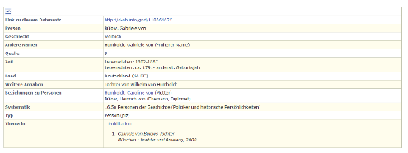
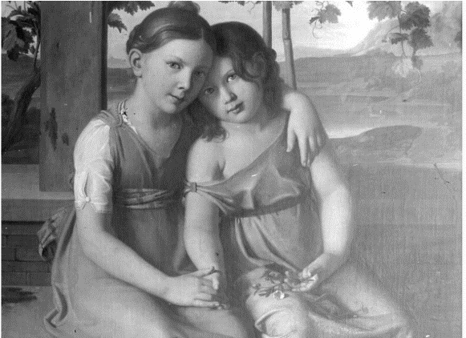
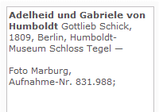
Bildarchiv Foto Marburg
GND
Notes:
Renate
Another example from the Bildarchiv Foto Marburg, from their collection of images
A photo from a painting from two daughters of Wilhelm von Humboldt
On top of the slide at the right you see the authority record from the GND for Gabriele von Humboldt

Slide 26
Historical Dictionary of Switzerland
Notes:
Christian
Or with the the Historical Dictionary of Switzerland

Slide 27
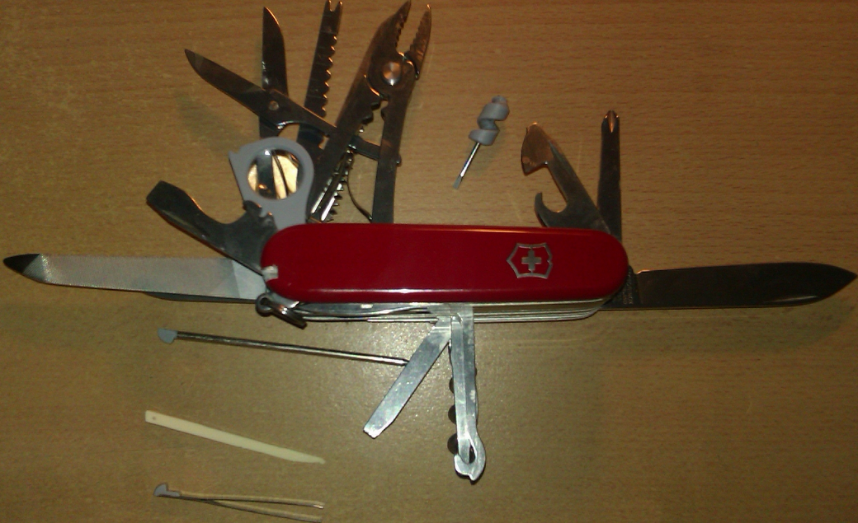
RDA – a tool for everything?
Notes:
Christian
Can RDA be a tool for everything? We think no.
We think that RDA has to be developed as a principle-based basic standard for all resources in a way to become a basic standard even for special materials and a starting point for the development or further development of other standards describing cultural heritage.

Slide 28
Conclusion
Supporting institutions in their daily work with RDA, e.g. problem-solving
Working groups for special materials with partners from different cultural sectors
Participation in the Development of RDA (e.g. restructuring of the RDA Toolkit)
Building up an organisational infrastructure for all institutions providing cultural heritage
Openness, Acceptance and Flexibility
Notes:
Renate
Weiterentwicklung der RDA
Ein Anfang im deutschsprachigen Raum ist gemacht und die begonnenen Arbeiten werden die Fachexpertinnen und Experten in den nächsten Jahren beschäftigen. Ziel der Arbeitsgruppen für Sondermaterialien ist es aber nicht nur, Lösungen für die konkrete Arbeit in den Institutionen zu finden. Diese kurzfristigen Lösungen werden für die praktische Arbeit gebraucht, gerade für Institutionen, die Ressourcen sowohl aus dem Bibliotheks- als auch aus dem Archivbereich sowie Objekte und nichtpublizierte Ressourcen in ihren Beständen halten und erschließen möchten. Darüber hinaus ist es den Kolleginnen und Kollegen aber ein großes Anliegen, an der Weiterentwicklung der RDA selbst mitzuarbeiten und verstärkt die Bedürfnisse der europäischen Community einzubringen. Die strategische Neuausrichtung, die das RDA Board zurzeit umsetzt, fordert auch genau dies, indem es die wirkliche Internationalisierung des Standards als eine der Prioritäten für die nächsten Jahre formuliert hat.
Was aber bedeutet dieser bislang nur theoretische Ansatz in der Praxis? Eine Öffnung des Standards RDA für weitere Kultureinrichtungen kann keine Einbahnstraße sein. Die Vorreiterrolle der Bibliotheken muss in eine wirkliche Partnerschaft münden. Das bedeutet, die RDA selbst müssen flexibler werden. Es ist bereits jetzt klar, dass eine 1:1 Adaption für Archive und Museen nicht infrage kommt. Die im deutschsprachigen Raum begonnene Anpassung und Verlinkung bestehender Standards aus diesen Bereichen mit dem RDA Toolkit ist z. B. ein Ansatz in diese Richtung. Auch die geplante Neustrukturierung des RDA Toolkit lässt hier auf Veränderungen hoffen und könnte eine große Chance für die Einbindung weiterer Kultureinrichtungen sein.
Grundvoraussetzung ist hierfür Offenheit und ein Blick auf das Wesentliche mit gleichzeitiger Akzeptanz für Veränderungen, auch wenn diese Veränderungen mit dem Verlust von geliebten Traditionen einhergehen. Auch wird das bereits in den RDA festgelegte Prinzip des „Cataloguers Judgement“ weiter ausgebaut werden müssen und der Standard RDA muss sich noch mehr zu einem Prinzipien-basierten Grundlagenstandard entwickeln der die Basis für Spezialregelwerke darstellt.
Die Nutzer unserer Kultureinrichtungen sind hier sicherlich schon einen Schritt weiter. Für sie besteht bei der Recherche zu einem Thema erst einmal kein Unterschied darin, ob es sich um eine Haarlocke, einen Briefwechsel, ein Buch oder ein Hörspiel handelt. Dies sollte uns zu denken geben und uns Ansporn sein.

Slide 29
RDA can be a basic standard
not in form of a takeover but as a
standard which is
Based on principles
Format-independent
International
Linked to other standards
Applicable in modern technical environments
RDA can be a nexus for cultural heritage and a linking point for cultural institutions.
Notes:
en
Renate

Slide 30
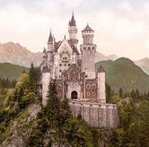
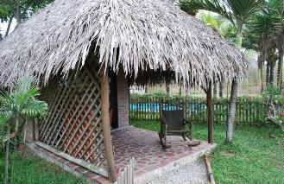
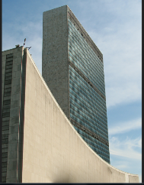
There are so many ways to build a house!
Notes:
Renate
Because there are so many ways to build a house or to work with standards for cultural heritage.

Slide 31
Thank you
Département fédéral de l'intérieur DFI
Office fédéral de la culture OFC
Bibliothèque nationale suisse BN
Christian Aliverti (Swiss National Library)
christian.aliverti@nb.admin.ch
Renate Behrens (German National Library) r.behrens@dnb.de
Notes:
Please contact us for questions or discussion!

