Slide 1


RDA Implementation from a Dutch and European Perspective
Daniel van Spanje
Senior Product Manager
Metadata Services
OCLC Netherlands
annette.dortmund@oclc.org
19 April 2013

Slide 3
Agenda
GGC: Dutch Shared Cataloguing System
RDA implementation
EURIG

Slide 4
OCLC offices around the world
Australia: Melbourne, Victoria
Canada: Brossard, Québec • Calgary, Alberta • Winnipeg, Manitoba
China: Beijing
France: Asnières sur Seine
Germany: Oberhaching • Berlin • Böhl-Iggelheim
Mexico: México City
Netherlands: Leiden
Switzerland: Basel
UK: Sheffield • Birmingham
USA: Dublin, Ohio (Headquarters) • Overland Park, Kansas San Mateo, California • Seattle, Washington

Slide 5
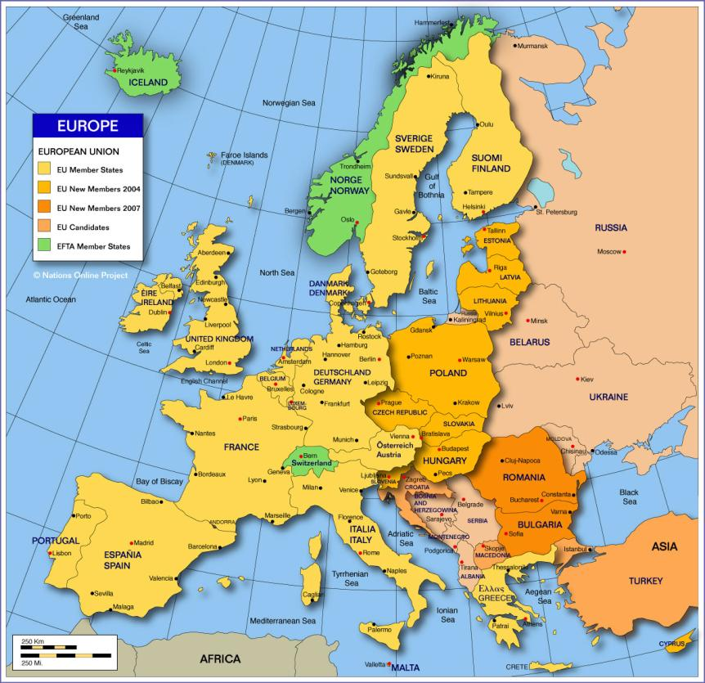

Slide 6
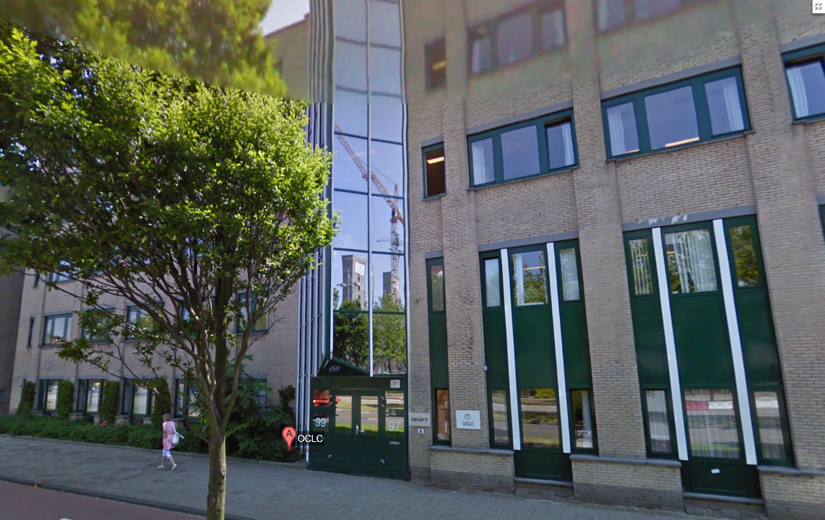

Slide 7

MARC 21 format
AACR 2 > RDA
Pica3 format
RT > RDA
WorldCat
289+ million records
18+ million records
GGC
Netherlands
Online synchronization

Slide 8
The Dutch customers
Consortium of National Library, 13 academic libraries and 14 large public libraries (28 “founding fathers”)
160 public libraries
Libraries of universities for applied sciences
Special research libraries
Other special libraries: hospitals, court libraries, museum libraries

Slide 9
Metadata strategy in The Netherlands
Standardization and internationalization
Further integration with WorldCat
Academic libraries moving to WorldCat
GGC as “metadata hub” (crosswalk service)
MARC 21 as standard exchange format
RDA as cataloguing rules

Slide 10
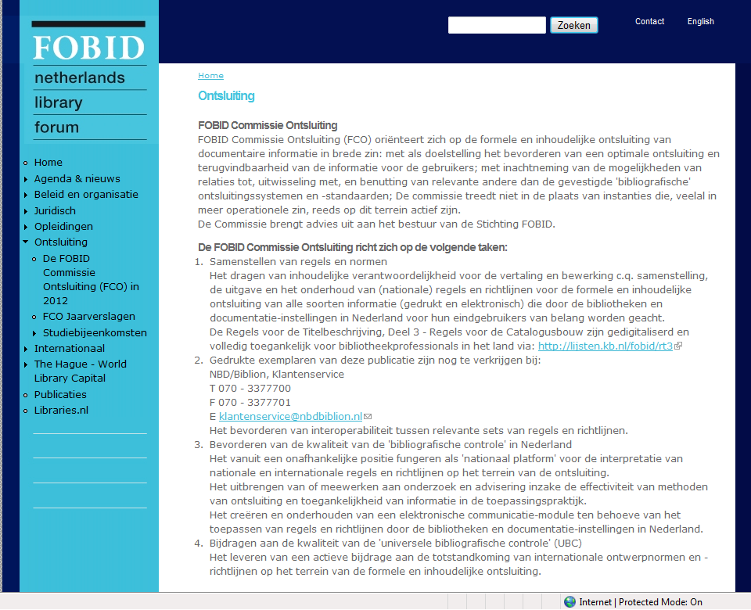
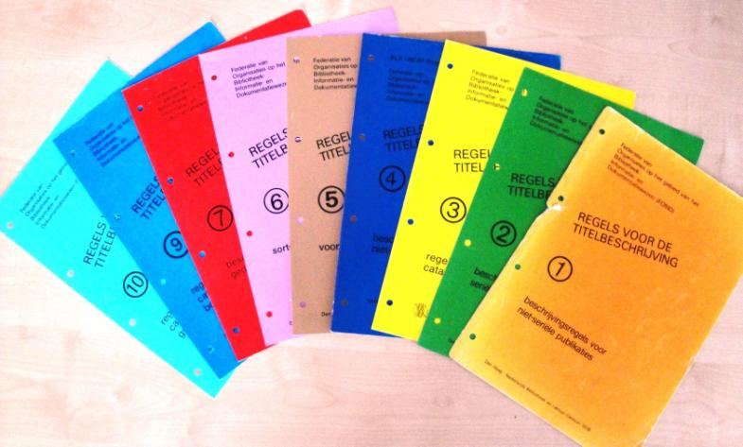
Regels voor de titelbeschrijving: RT
Dutch Rules for Cataloguing

Slide 11
RT ➔ RDA
MARC 21 standard exchange format
Decision of the Dutch Consortium Steering Committee on 18 February 2013
Decision of the Dutch FOBID Board on 19 February 2013

Slide 12
RDA Projectgroup
Create framework for RDA implementation in The Netherlands (project SLIM 3.0)
Organize the “RT to RDA” Guidelines Working Group
Results: 6 reports with recommendations:

Slide 13
RDA Projectgroep: results
1. Translation
2. Workflows
3. Training
4. Language of cataloguing
5. Creation of work records
6. Support and development of RDA

Slide 14
1. Translation
Proposal:
do not translate RDA. Take the glossary. Do not translate the concepts, but translate the explanations

Slide 15
2. Workflows
Proposal:
Create general workflow in Dutch. Translate the “RDA in ten easy steps” by Thomas Brenndorfer as an example to introduce the “FRBR-mindset”
Integrate the RDA documents of the Dutch working groups in the RDA Toolkit

Slide 16
3. Training
Proposal:
Create a freely accessible general RDA introduction in Dutch on the web
Discuss with the Dutch training companies the possibility to offer a more detailed and practical training

Slide 17
4. Language of cataloguing
Proposal:
The registration of the language of cataloguing in a bibliographic or authority record will be mandatory
Choose the most appropriate language of cataloguing (Dutch, English, French, German, Latin)

Slide 18
5. Creation of work records
Proposal:
Create work records if needed
Limit the creation of work records to specific categories.
Ask the National Library and OCLC to create detailed guidelines

Slide 19
“RT to RDA” Guidelines Working Group
List of RDA Core elements
List of differences between RT and RDA:
  Item, manifestation, expression, work
  Authorities
  General guidelines
Create policy statements for alternatives and options and decide to follow LCPS yes/no (e.g. rule of three).

Slide 20
What will happen in the GGC (shared cataloguing system)

Slide 21
GGC per 1 april 2013
Add Type of content, Type of medium and Type of carrier (mandatory per 1st of january 2014).
Add language of cataloguing
Add relator codes

Slide 22
GGC per 1 july 2013
Database retrospectively populated with type of content, type of medium, type carrier
No rule of three; record all
No abbreviations
No latin
Do not change/correct text
Introduce year of copyright
Register the cataloguing rules: RDA , AACR2, RT

Slide 23
GGC per 1 january 2014 ?
Create Works / Expressions
Create RDA authorities

Slide 24
6. Support and development
  Proposal:
  Investigate a consortium license for the RDA Toolkit
  Integrate Dutch Working Group documents into the RDA Toolkit
  Organize RDA support and install:
  RDA Servicedesk (National Library)
  Dutch Committee on RDA

Slide 25
RDA servicedesk and support
IFLA
JSC RDA
Libraries
FOBID
RDA Committee
EURIG
Libraries
RDA servicedesk

Slide 26
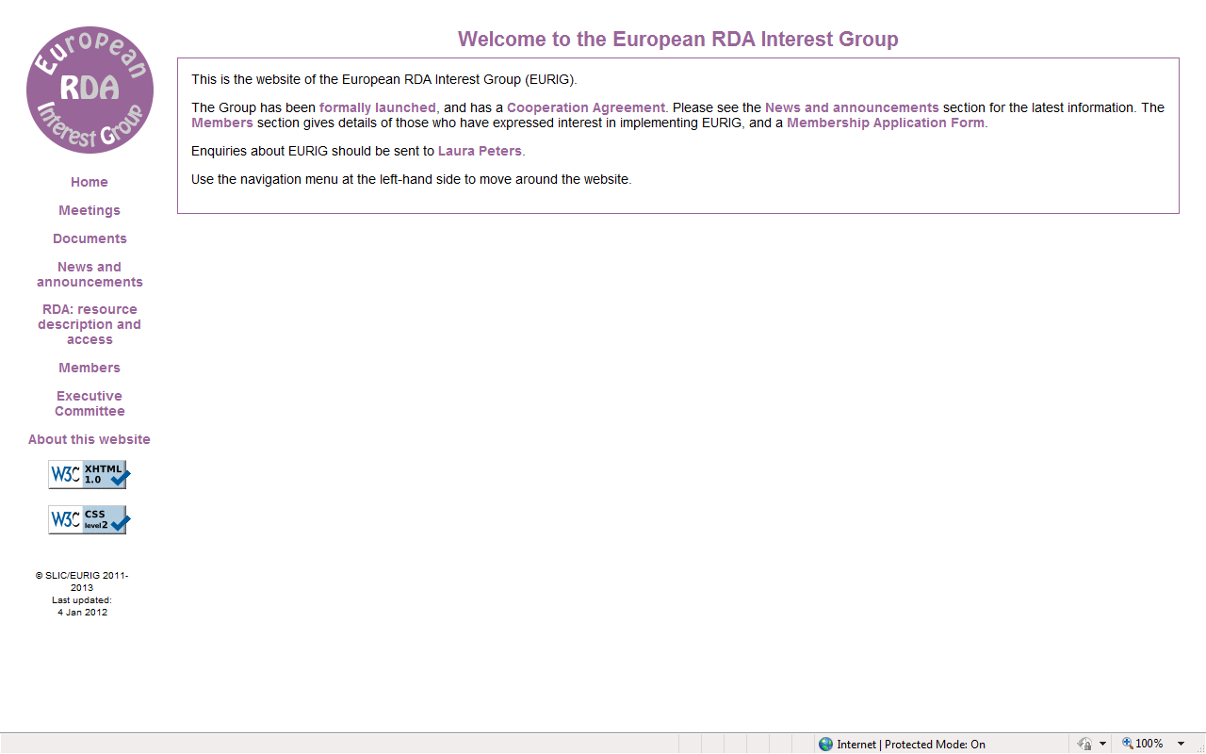


Slide 27
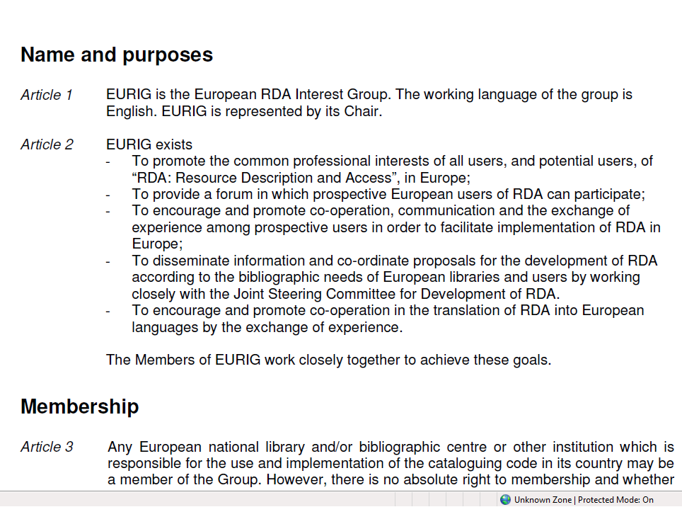
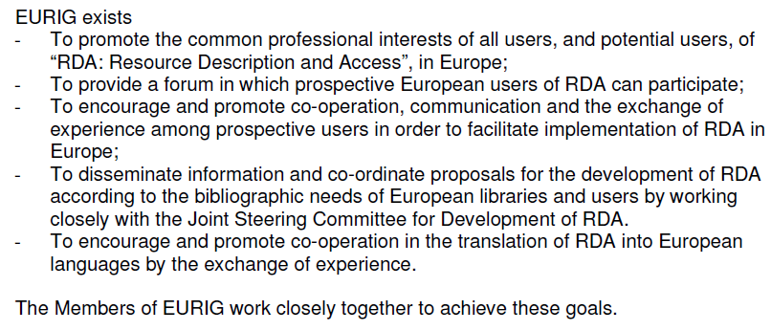

Slide 28
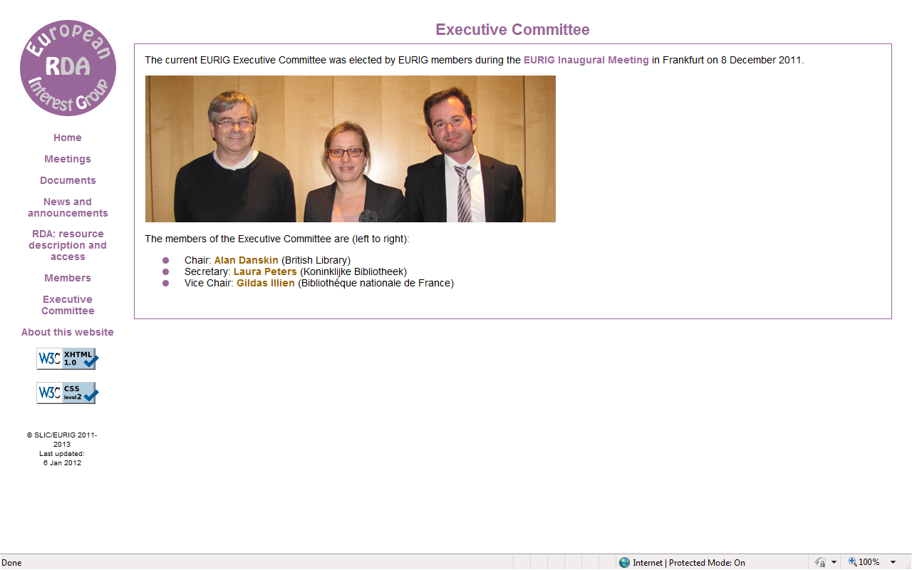

Slide 29
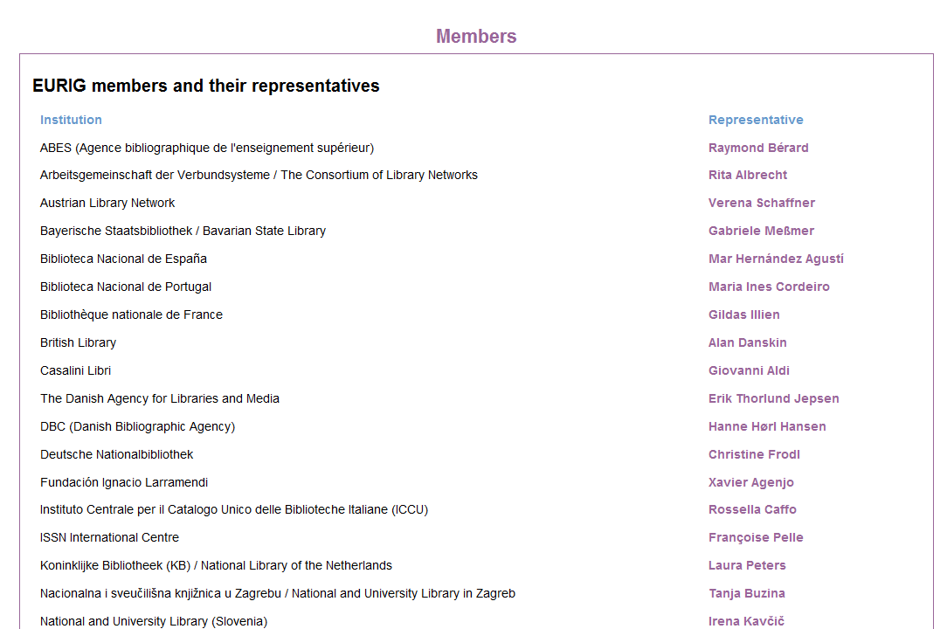

Slide 30
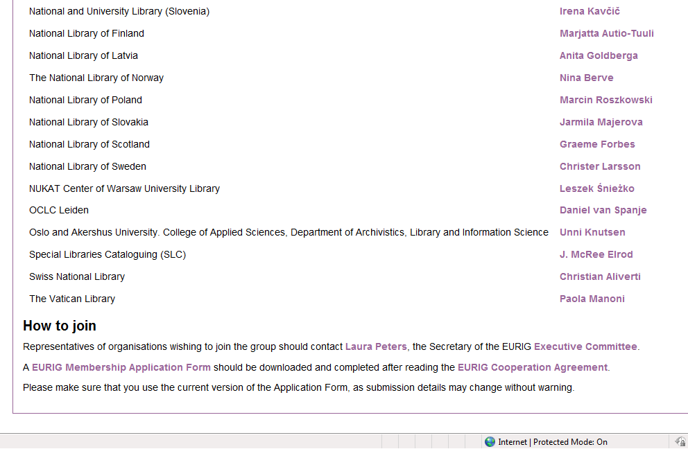
1. National Libraries
2. Consortia
3. Other

Slide 31
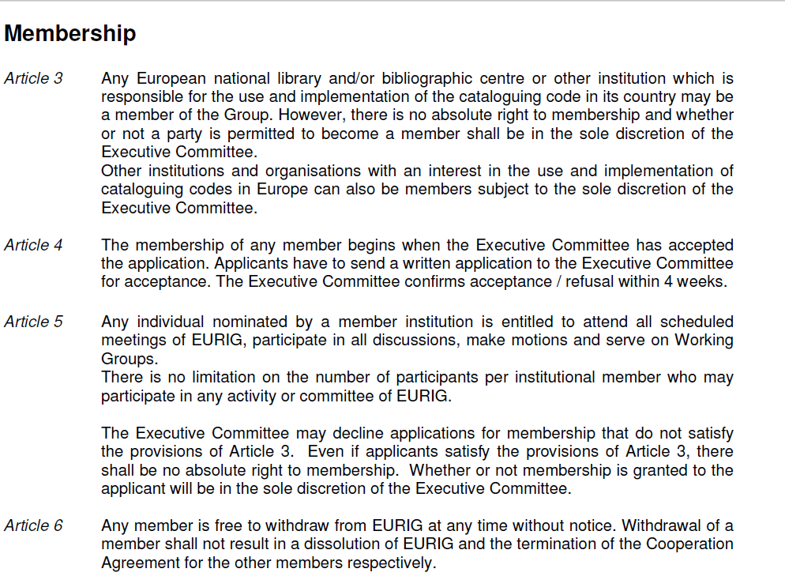

Slide 32
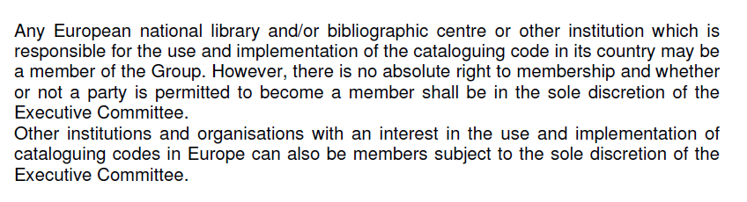
Membership. Article 3.

Slide 33
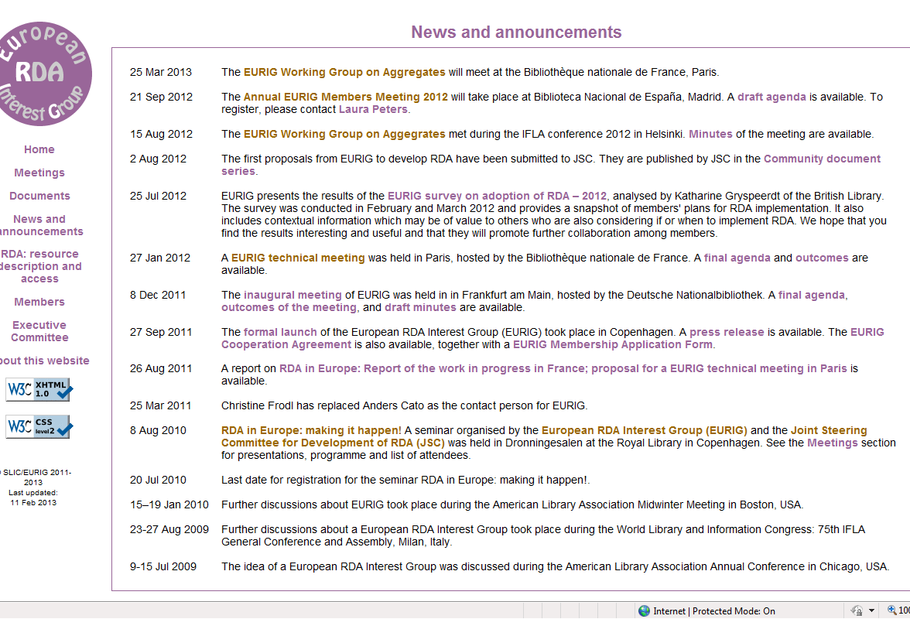

Slide 34
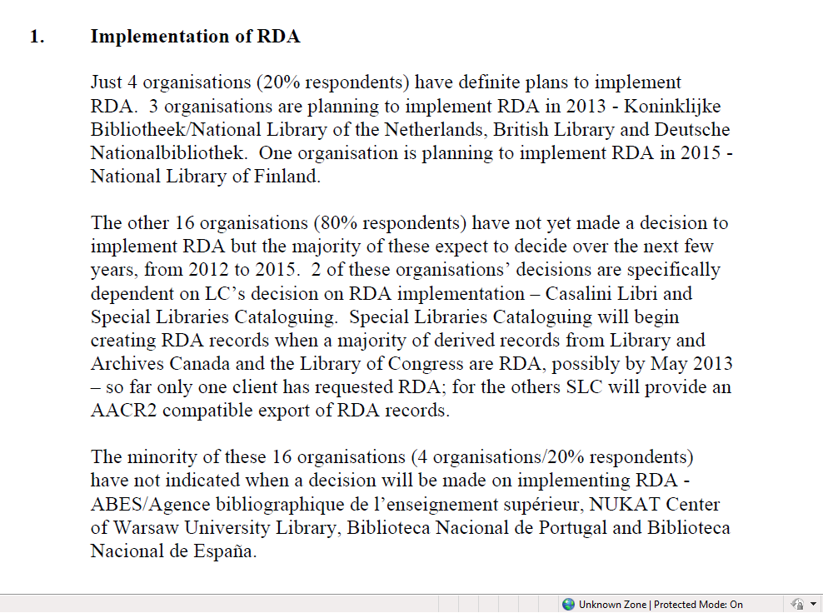

Slide 35
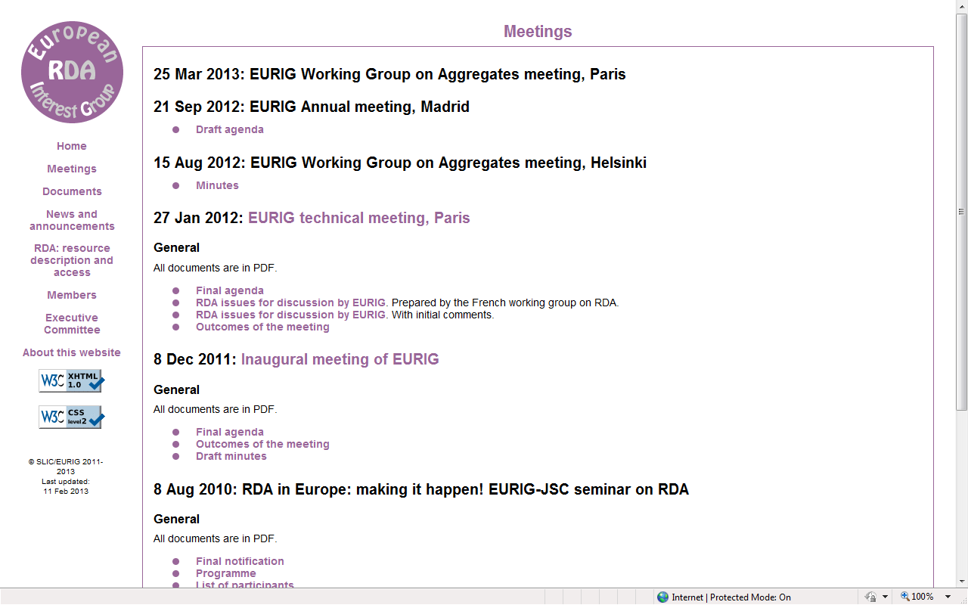

Slide 36
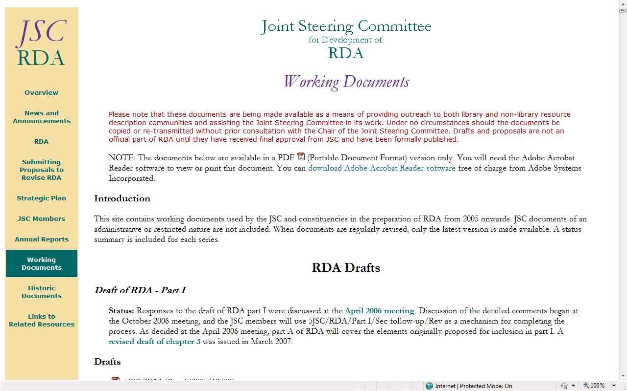

Slide 37
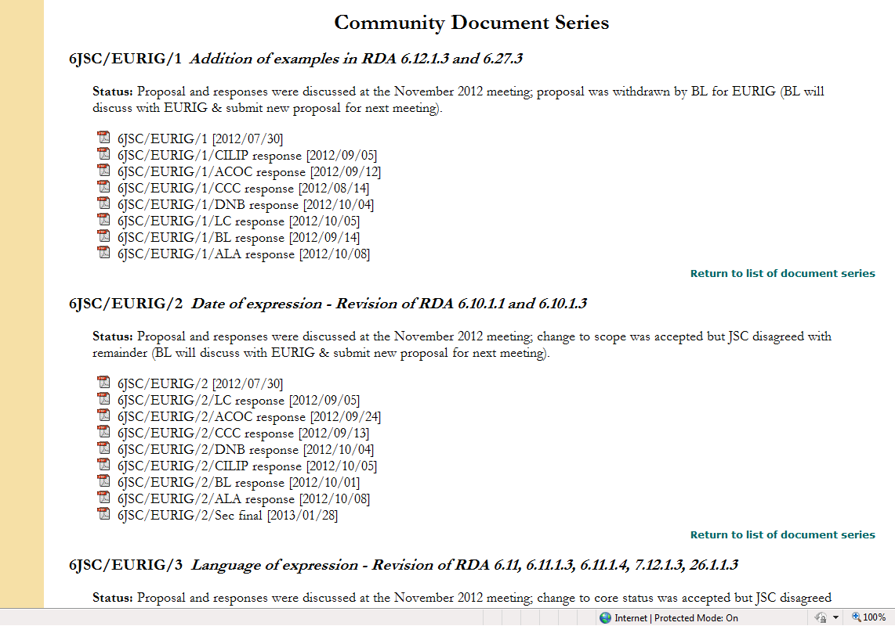

Slide 38
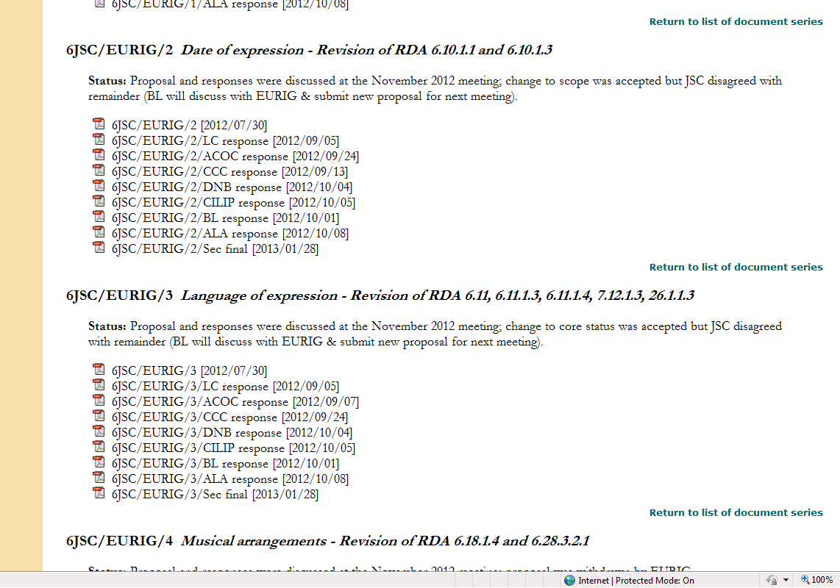

Slide 39
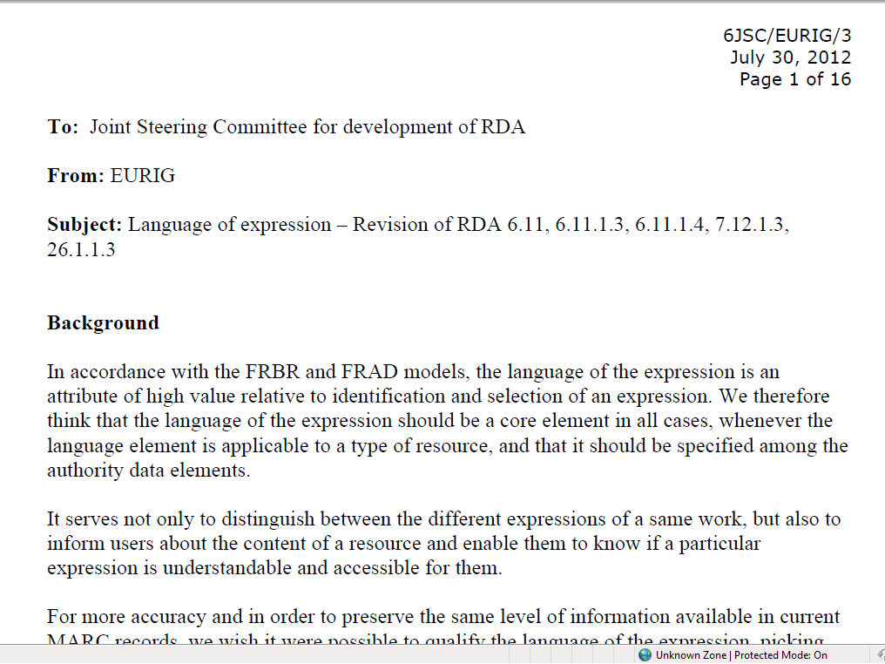

Slide 40
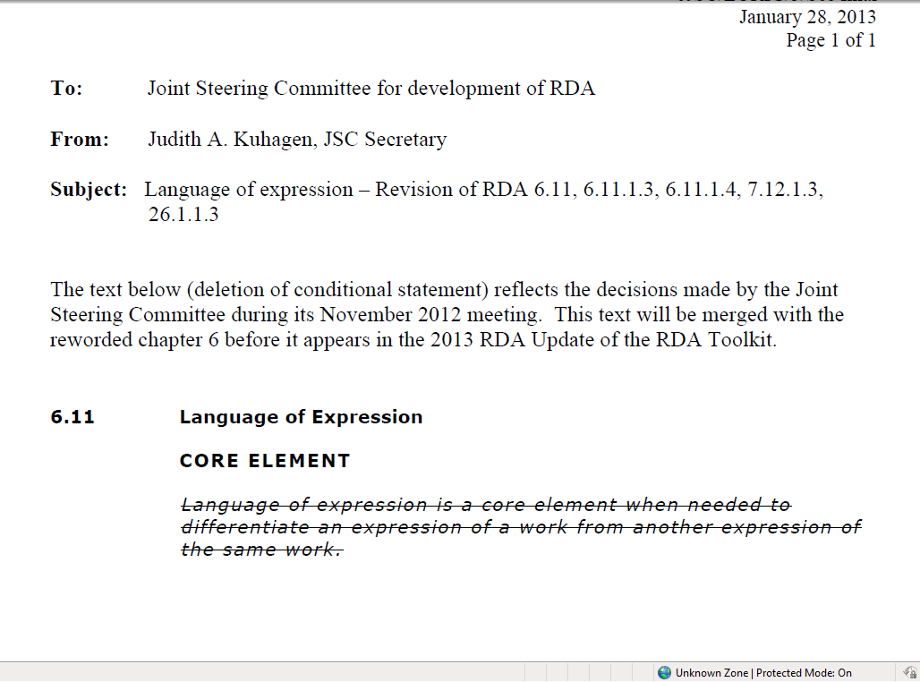
！
！ ！

Slide 41
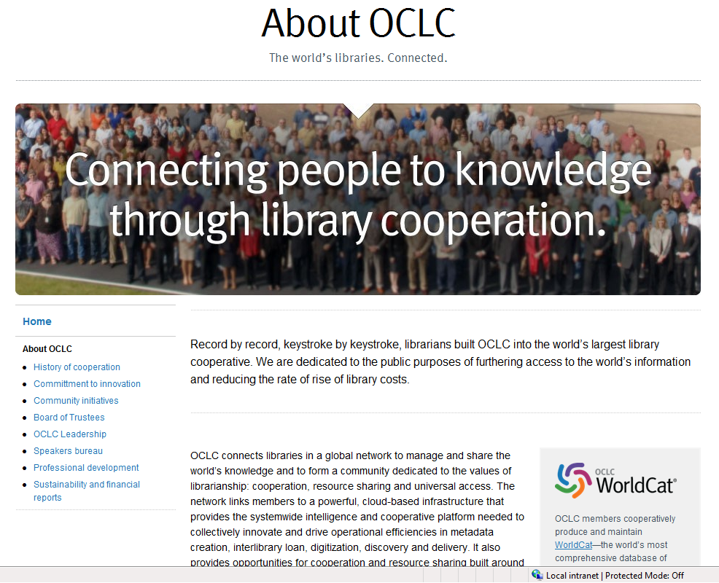


19 – 20- september 2013
National Library of Sweden
Stockholm

Slide 42
Thank You!

