Slide 1
Automatic subject cataloguing at the DNB
Christoph Poley, DNB
1
EMa

Slide 2
2
Short overview
History of automatic subject cataloguing at DNB
Productive environment:
  Architecture
  Some results
Focus on activities
Main Questions

Slide 3
A Challenge of mass
3

Slide 4
4
Timeline
2010
Retirement of intellectual cataloguing of online publications
since 2014
Automatic indexing of GND descriptors
2017
Automatic indexing of print publications with GND desciptors
2019
Start Project Erschließungs-maschine (indexing machine, EMa)
2021
Start AI-Project
2024
All use cases are in production with EMa Software
2009
Start PETRUS-Project
since 2012
Automatic classification of DDC-subject groups
2015
Automatic classification of DDC short numbers
2018
Automatic indexing of English online publications; automatic language guessing (ISO 639-2/B)
2020
Automatic indexing of children’s and young adult literature
2022
Project EMa turned into productive use
2023
Data management with DVC

Slide 5
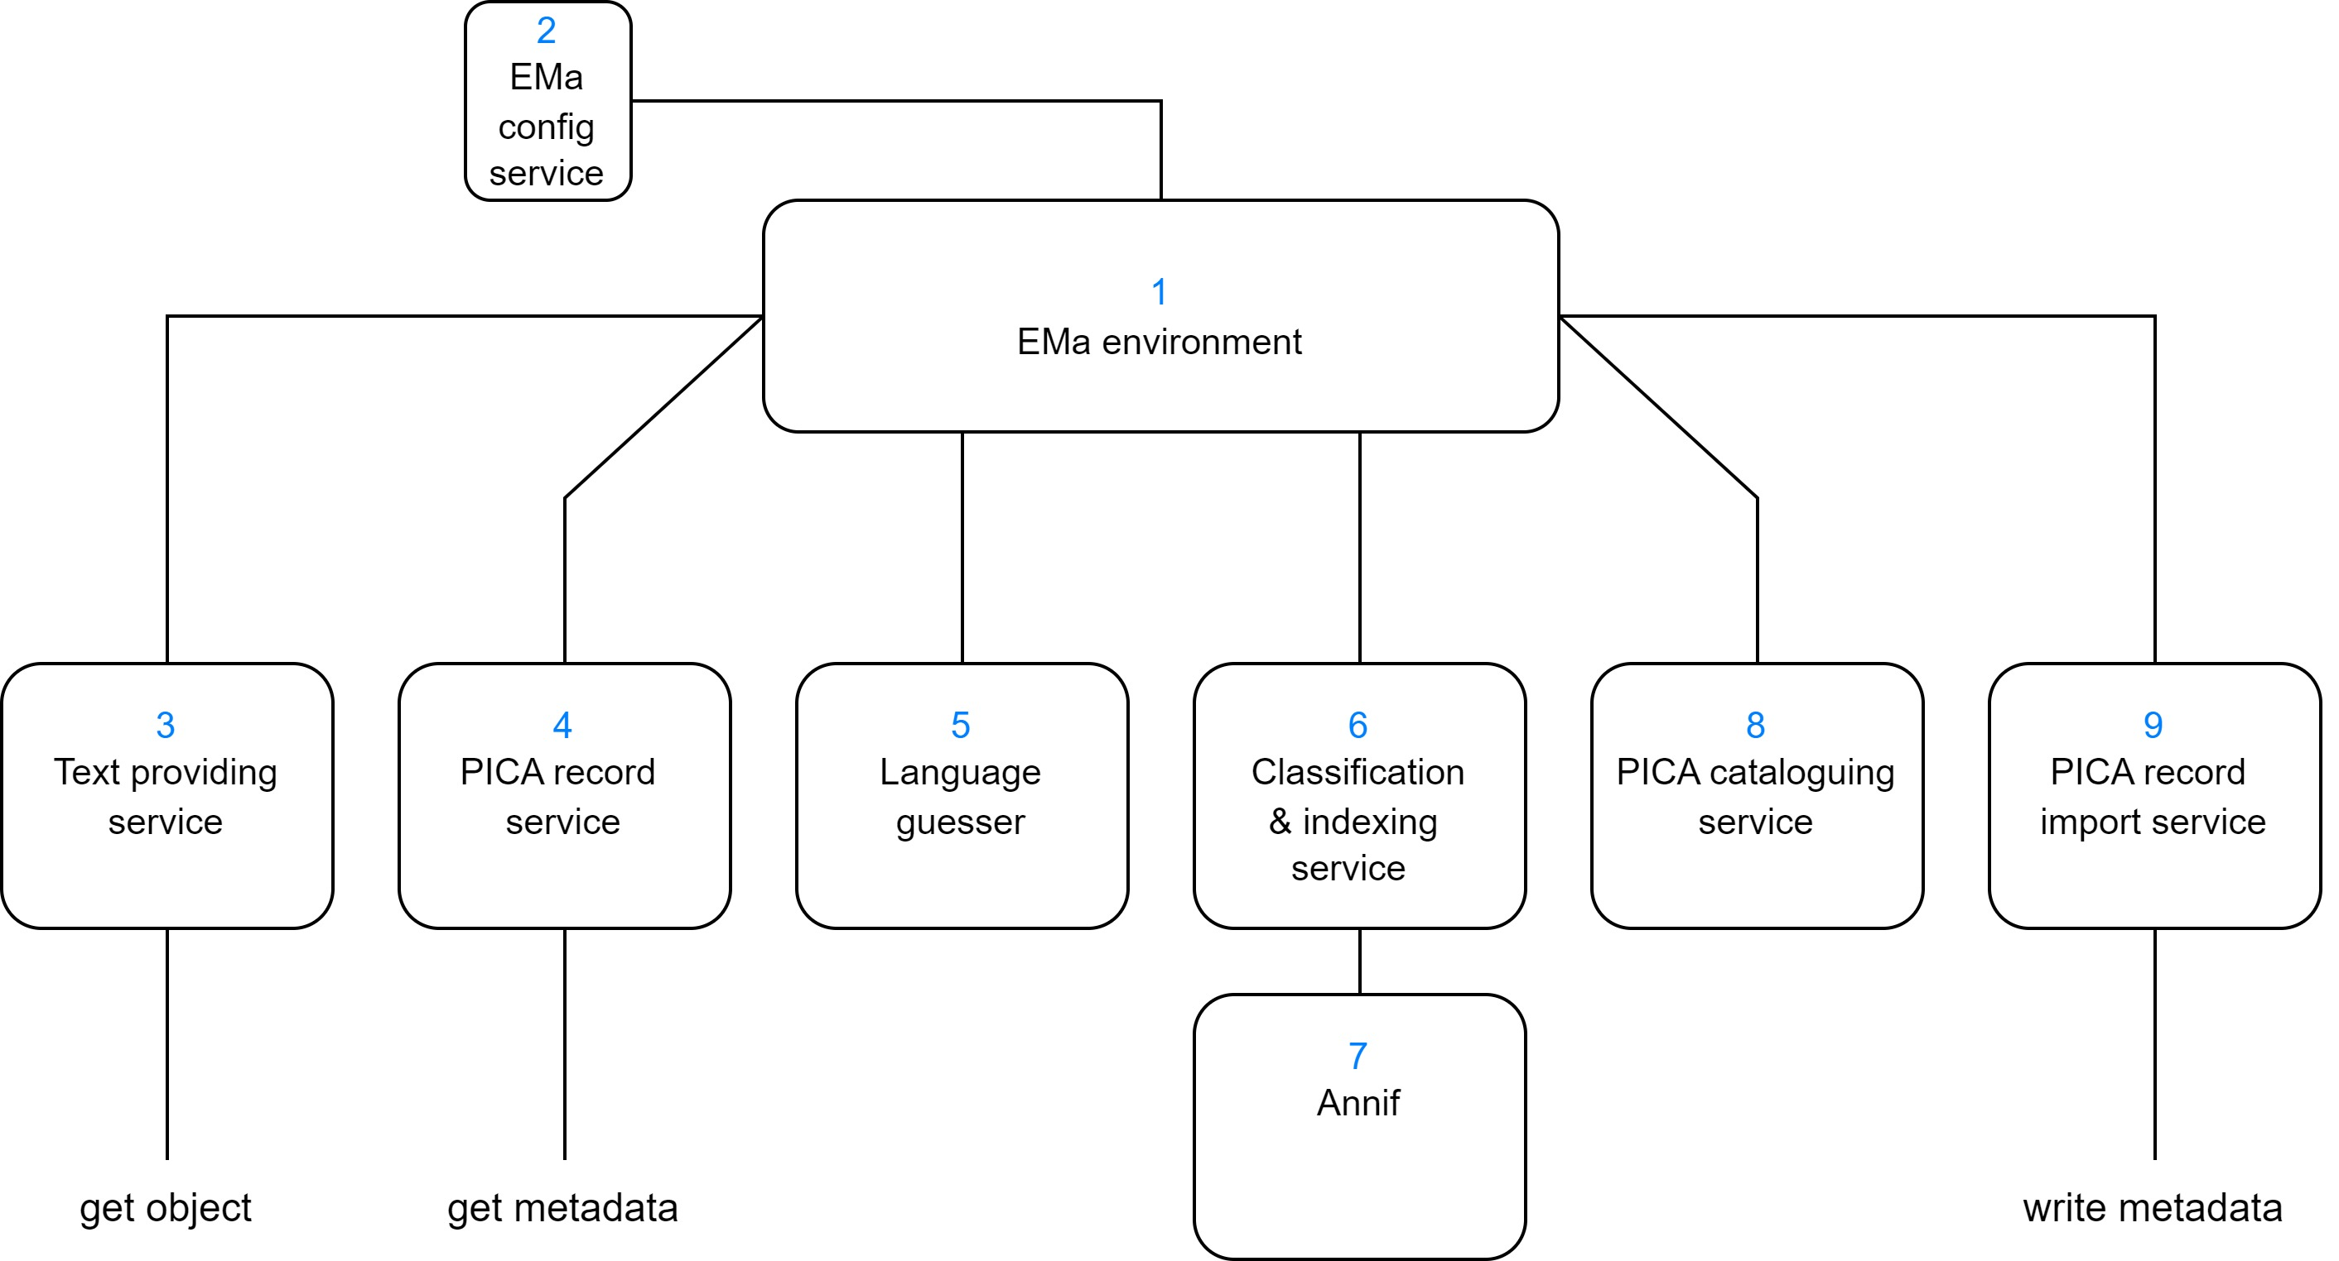

5
EMa‘s productive environment: Services

Slide 6
Productive workflow
#documents
6
Automatic classification with DDC Subject Categories | 2023 | Total
German-language digital publications | 188,057 | 1,662,355
English-language digital publications | 1,123,751 | 4,562,769
German-language printed publications | 13,115 | 99,226
English-language printed publications | 3,178 | 22,457
Sum: | 1.328.101‬ | 6.346.807‬
Automatic indexing with GND descriptors | 2023 | Total
German-language digital publications | 142,792 | 1,039,305
English-language digital theses | 10,313 | 56,257
German-language printed theses | 2,069 | 23,243
Publications in children's and young adult literature | 12,246 | 53,452
Sum: | 167.420 | 1.172.257

Slide 7
7
Automatic subject cataloguing
of online and selected print publications
DDC subject categories
Machine learning approaches
Training data for 100 main subject groups (German)
  Medicine and health: 404,891 | Law: 283,941 | Theology: 176,558
  Greek: 753 | History of South America: 717 | History of other regions: 142
  Full text: 275,460 | title: 1,995,055 | toc: 998,194
Results German literature limit 1 threshold 0.00
DDC Short Numbers (for 54 subject categories)
Modell | Precision | Recall | F1-Score
SVC | 0,7917 | 0,7871 | 0,7886
Omikuji | 0,7824 | 0,7777 | 0,7793

Slide 8
8
Trend analysis DDC subject categories
productive
Growing experiences in training and testing
Introduction of data management tools, …

Slide 9
9
Automatic subject indexing with GND
of online and selected print publications
XLMC problem
GND Vocabulary: All available descriptors: 1,402,967
GND descriptors with training data: 221,924 (16%, long tail problem with zero shots)
Machine learning approaches, lexical approaches
Results limit 7 threshold 0.04 (lang ger)
Model | #training | Precision | Recall | F1-Score | NDCG
mllm ft | 5,000 | 0,1899 | 0,4259 | 0,2402 | 0,3971
omikuji toc | 724,038 | 0,3904 | 0,4573 | 0,3573 | 0,4632
omikuji ft | 196,538 | 0,3929 | 0,5118 | 0,3902 | 0,5137
omikuji title | 1,414,972 | 0,4423 | 0,4941 | 0,4142 | 0,5025
ensemble |  | 0,4550 | 0,6124 | 0,4738 | 0,6093

Slide 10
10
Trend analysis GND descriptors
productive
+ “power” of ensemble algorithms

Slide 11

11
Focus on activities
Optimize automatic subject cataloguing
  Experiments with Fusion of results
  Explore potential of LLMs
  Development of pica-rs
  Create gold standard
Reengineering of EMa environment
  free configurable plug-in-box
  important base for knowledge transfer from DNB‘s AI project
Collect and analyse information about text quality (after extraction) and further Bibliographic metadata
Practice paper about automatic subject cataloguing @DNB
Notes:
Optimize automatic subject cataloguing
Experiments with Fusion of results
Explore potential of LLMs
Development of pica-rs
Create gold standard (“human in the loop”)
Ggf. Extend object groups to catalogue
Ggf. Improve data management
Reengineering of EMa environment to a free configurable plug-in-box
Allow free combination (fusion) of suggested metadata
important base for knowledge transfer from DNB‘s AI project
Collect and analyse information about text quality (after extraction)
Metrics to sort out „bad“ text
Tools for text post processing (e.g. line breaks with hyphens)
Bibliographic metadata
Content of PDF files is more than text
Extract structure
Extract metadata
Practise paper about automatic subject cataloguing @DNB

Slide 12
Main questions
12
What are your main developments concerning annif for the next time?
  Annif Backends
  Text processing
  Usage of vocabularies
What is annif‘s position/strategy using large language models? Do you plan methods to adapt them (e.g. Hugging face?)
Will automatic extraction of metadata get or a part of Annif (or a new toolbox)?

Slide 13
Thank you for your attention!
13
mailto: c.poley@dnb.de
AE-info@dnb.de
Thank you!

