Slide 1
Some Lessons Learned in DNB’s AI Project:
Evaluation, Existing Methods, New Methods
1
Maximilian Kähler
Notes:
Some Info on the project:
Funded by Germanys National AI Strategy we have been working on automated subject indexing since 10/2021
The project aims to increase quality of subject indexing at DNB by employing novel NLP techniques and help fortify data science and machine learning competence at DNB

Slide 2
Table of Contents
2
Benchmarking XMLC-Methods on German Scientific Literature
Research on our Own Methods
  Embedding Based Matching
  Few-Shot Prompting LLMs (→ Lisa‘s Talk)
Notes:
Beside creating tools for our internal data management and evaluation of automatet subject indexing, the project has had two main lines of research

Slide 3
1. Benchmarking XMLC-Methods on German Scientific Literature

Slide 4
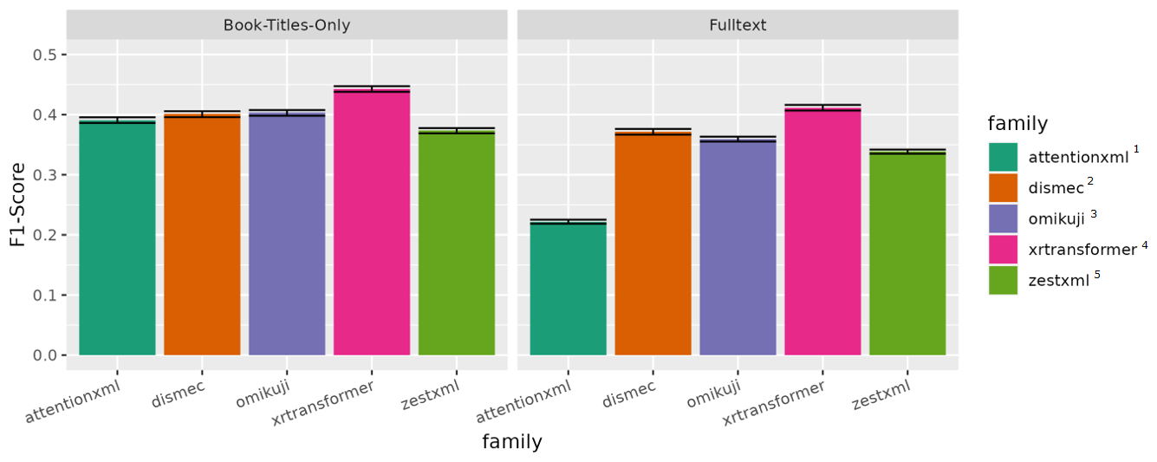
Benchmarking XMLC-Methods*
4
Note: AttentionXML and Omikuji are ensembled with multiple instances. XR-Transformer is not (yet). Hyperopt for XR-Transformer is not yet completed
Test-Set: Methods are evaluated on a test-set of 8415 German scientific text books, equally spread across 18 different subject categories
^{1,2,3,4,5}Resources: see last slide
*Intermediate Project-Results as of 09/2024
Notes:
We evaluate methods on two tasks: Indexing book titles and indexing fully text
We try to look at results in far more detail then this, but there is no time for that now
Hyperopt for XR-Transforer has been very complex. One week ago, we thought XR-Transformer would not work for us!
More on single methods:
xtransformer, attentionxml are deep-learning approaches
Dismec is a OneVsAll classifier
Omikuji uses partitioned label trees (known in Annif)
ZestXML is the only XMLC-Method so far that can employ label features and shows (weak) zero shot learning capabilities

Slide 5
Outlook Benchmarking:
5
All methods undergo a qualitative rating by our subject experts (which will give us an interesting point of comparison beyond F1-Score)
We are still looking for methods that might successfully combine label features and efficient learning algorithms*(e.g. DECAF⁶, PINA⁷)
Evaluate contribution of individual methods to a potential heterogeneous ensemble of methods
*so far ZestXML is the only approach in our comparison to integrate label features into the classifier learning
^{6,7}see last slide
Notes:
Qualitative rating will give us an impression beyond binary relevance metrics, how useful suggestions are, even if they do not hit gold standard
Most XMLC-methods treat Labels as abstract identifiers and are not able to effectifely leverage label features, s.a. prefLabels
As a single approach methods may have weak preformance in terms of F1-Score, but yet have „hidden strength“ in partial domains of the vocabulary or document-categories
Even a method outperforming Omikuji might add little to the existing production ensemble of MLLM and Omikuji
Evaluating heterogeneity of result list will move into our focus in this later stage, now that we have collected so many result.

Slide 6
2. Research on our Own Methods: Embedding Based Matching
Notes:
In this second part of the talk I would like to talk about a self-designed apporach, that does not fit into the XMLC paradigm, but is rather close to lexical matching

Slide 7
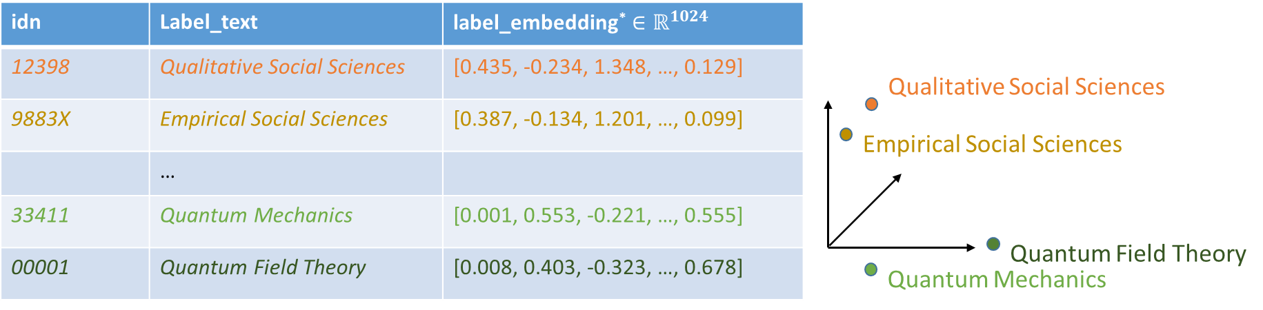
Idea: Represent Labels with Text-Embeddings
7
Saving embeddings for large vocabulary in vector storage along with text representation enables hybrid search:
Search for similar embeddings (using optimised HNSW-Graph-Search⁸)
Search for similar texts (using BM25)
*embeddings on slide are faked
Notes:
Many call this type of vector search semantic search, due to ist ability to map similar concepts to similar regions of space
Vector Search would normally require calculating dot-products for each item in a large vocabulary.
Most modern Vector Storages implement optimised search with

Slide 8
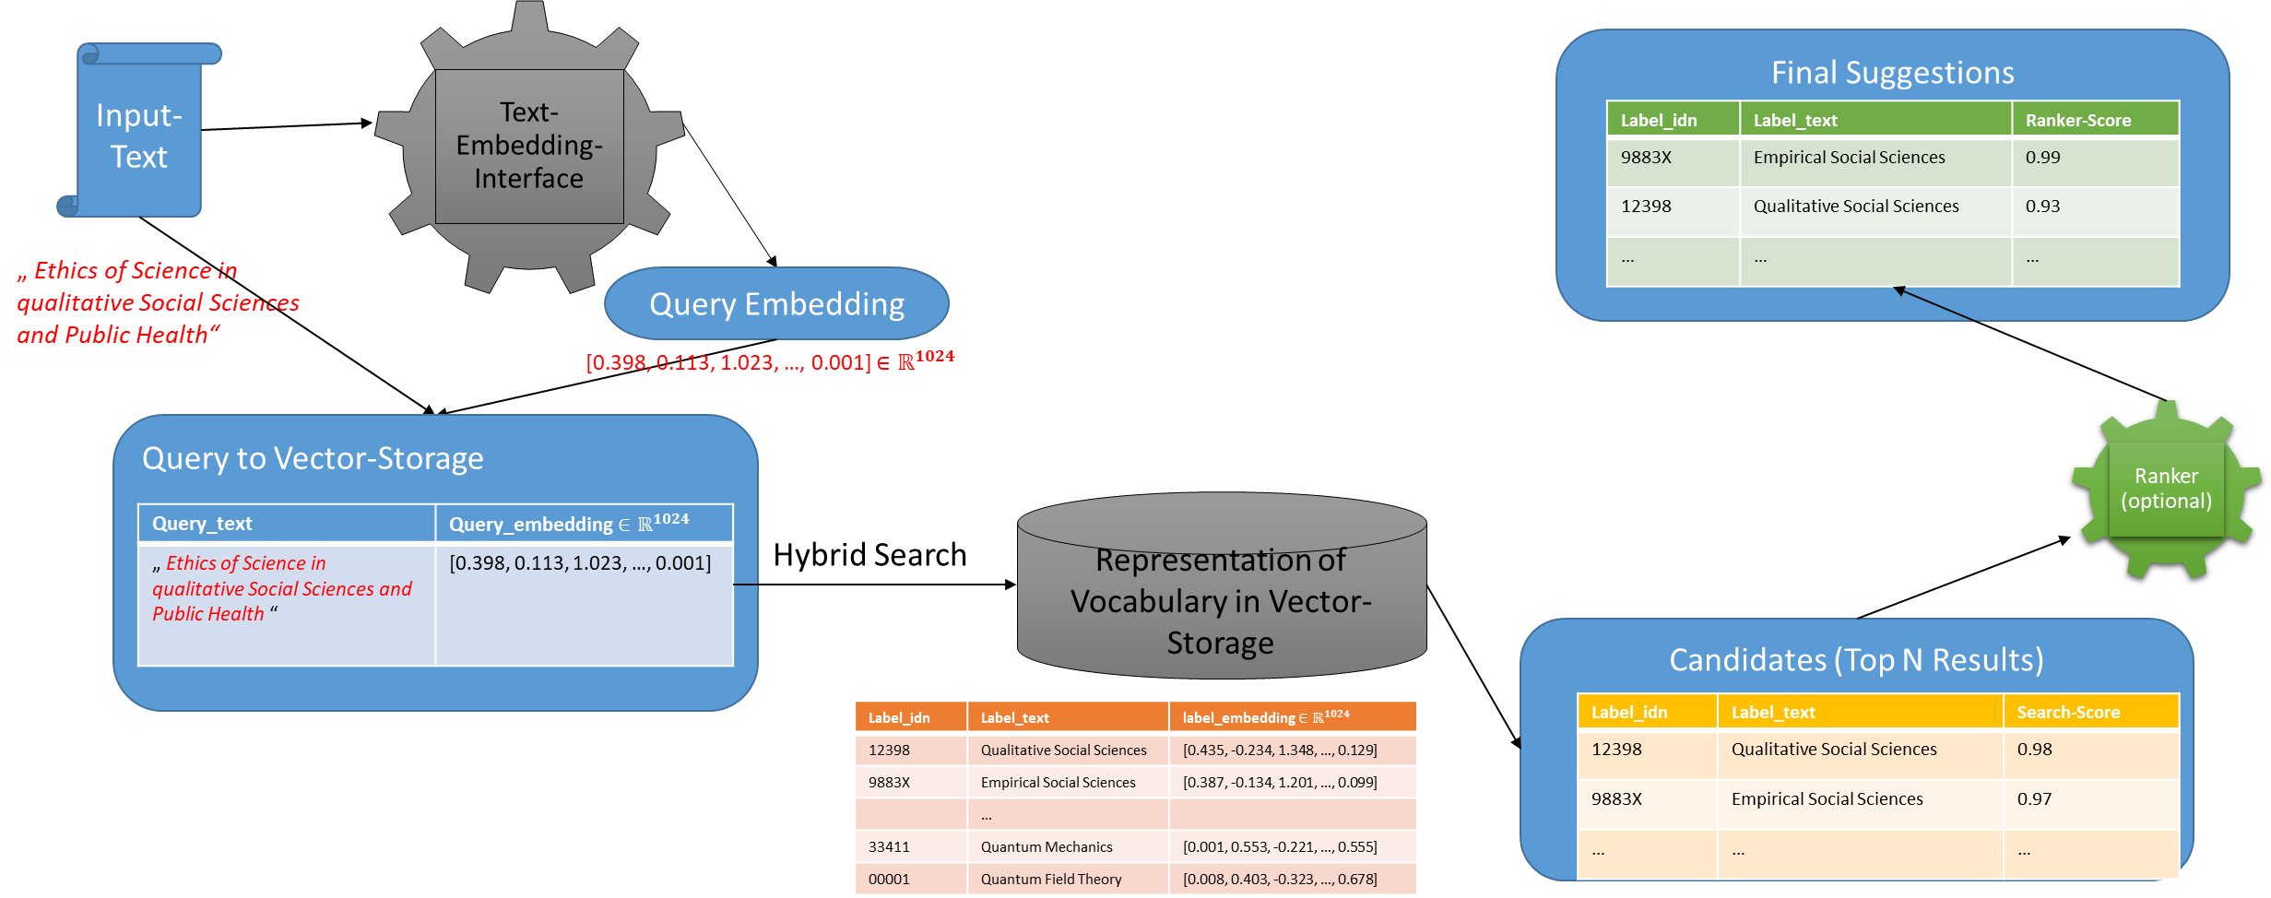
Workflow: Embedding based matching
8
Database may store more label-meta-data, e.g. alt or hidden-labels
Optional: Chunk longer Input-Texts into many queries
Notes:
Longer Text Inputs are chunked into pieces, for example with a sentence tokenizer like MLLM
Vector Storage may hold representation of alt-Labels and hidden-labels.

Slide 9
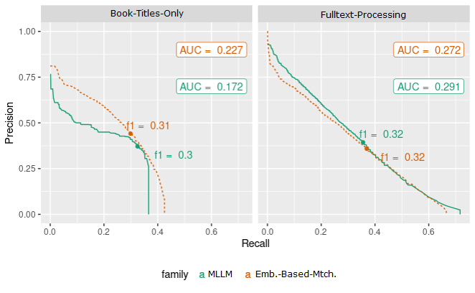
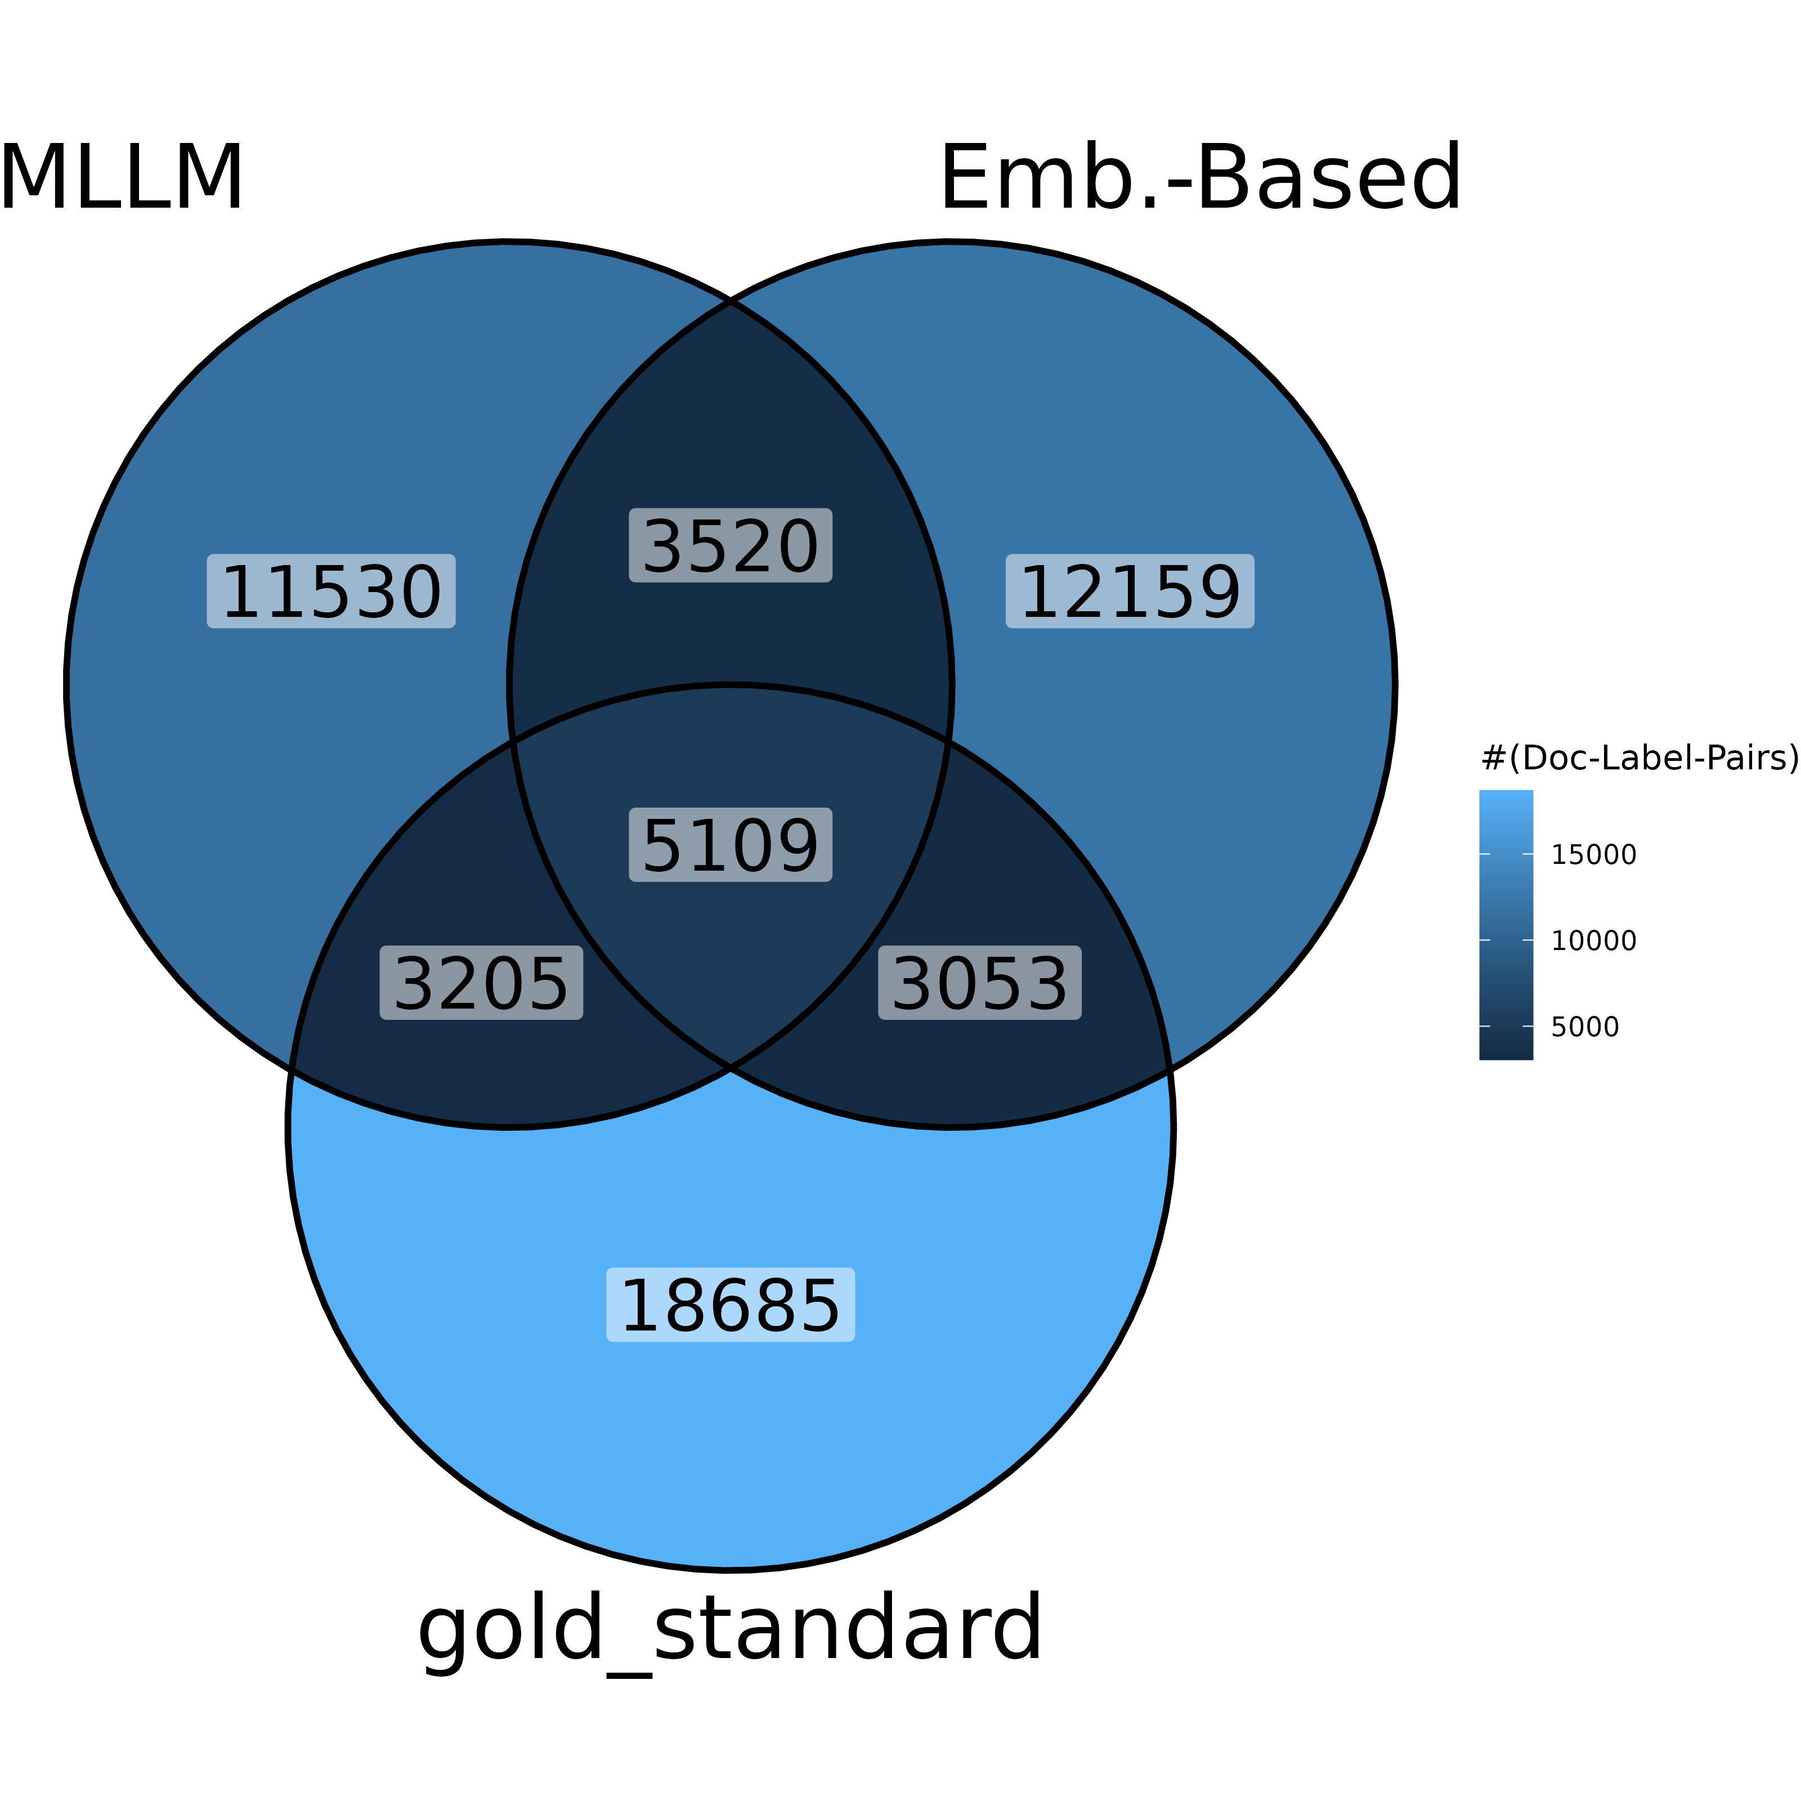
Results: MLLM vs. Emb.-Based-Matching
9
Precision-Recall-Curves
Intersection of Results Lists (fullttext models)
Notes:
Looking at bare f-scores MLLM and Emb.-Based-Matching end up similar
- Precision for bare book titles is better with Emb.-Based-Matching
MLLM slightly better on full texts
However: Results lists are not very similar!!!

Slide 10
Summary: Embedding Based Matching
10
Infrastructural requirements: Vector Storage for Vocab, Text Embedding Interface (GPU-Acceleration useful)
Many similarities to lexical matching, including strong zero-shot capabilities. But: non-similar suggestions!
There might be possibilities for improvement in advanced chunking or embedding strategies, developed in current RAG-Research (e.g. ColBERT-Embeddings or Late chunking)
Interesting baseline for a) LLM-based approaches b) fine-tuned transformers
Notes:
- Vector storage and TEI can be hosted almost off-shelf as containers and support many embedding models
From the XMLC-Perpective: Embedding based matching is an untrained OvA-Classifier, where the embedding of each label serves as weights for a linear decision function. Fine-Tuning methods must improve on that
Lisa will talk about Open-Source-LLMs. It uses the same infrastructure + the containers serving the LLMs

Slide 11
Thank you!
11
Project-Team: Lisa Kluge, Katja Konermann, Nico Wagner, Markus Schumacher
Please get in touch for further questions and discussion:
Maximilian Kähler
  m.kaehler@dnb.de
Our Project@DNB:
  https://www.dnb.de/ki-projekt
  https://blog.dnb.de/texte-erschliessen-mit-ki/

Slide 12
Appendix

Slide 13
Resources
13
You etal. (2019). AttentionXML: Label Tree-based Attention-Aware Deep Model for High-Performance Extreme Multi-Label Text Classification. NIPS’19: Proceedings of the 33rd International Conference on Neural Information Processing Systems. https://doi.org/10.5555/3454287.3454810
Schultheis, E., & Babbar, R. (2021). Speeding-up One-vs-All Training for Extreme Classification via Smart Initialization. https://doi.org/10.48550/arxiv.2109.13122
Omikuji: An efficient implementation of Partitioned Label Trees (Prabhu et al., 2018) and its variations for extreme multi-label classification, written in Rust. https://github.com/tomtung/omikuji
Zhang etal. (2021). Fast Multi-Resolution Transformer Fine-tuning for Extreme Multi-label Text Classification. https://arxiv.org/abs/2110.00685v2
Gupta etal. (2021). Generalized Zero-Shot Extreme Multi-label Learning. Proceedings of the ACM SIGKDD International Conference on Knowledge Discovery and Data Mining, 527–535. https://doi.org/10.1145/3447548.3467426
Mittal etal. (2021). DECAF: Deep Extreme Classification with Label Features. Proceedings of the 14th ACM International Conference on Web Search and Data Mining, 49–57. https://doi.org/10.1145/3437963.3441807
Chien etal. (2023). PINA: Leveraging Side Information in eXtreme Multi-label Classification via Predicted Instance Neighborhood Aggregation. Proceedings of Machine Learning Research, 202, 5616–5630. https://arxiv.org/abs/2305.12349
Malkov & Yashunin (2016). Efficient and robust approximate nearest neighbor search using Hierarchical Navigable Small World graphs. IEEE Transactions on Pattern Analysis and Machine Intelligence, 42(4), 824–836. https://doi.org/10.1109/TPAMI.2018.2889473

Slide 14
Pros and Cons of Deep-Learning Approaches
14
Pros | Cons
Deep-Learning approaches do not solely rely on statistical features (s.a. tfidf) with bag-of-words assumption Feature-Representations are fine-tuned to Label-Classification-Problem Offer highest Performance w.r.t. retrieval metrics Can built on pre-trained embeddings | high Resource-Consumption; GPU capabilities are must have trouble processing longer input-text* Large Training-Corpora required
*XR-Transformer can learn from tfidf, too, though
Notes:
We do not cover this to save time, but it can be added to the final workshop slides

