Slide 1
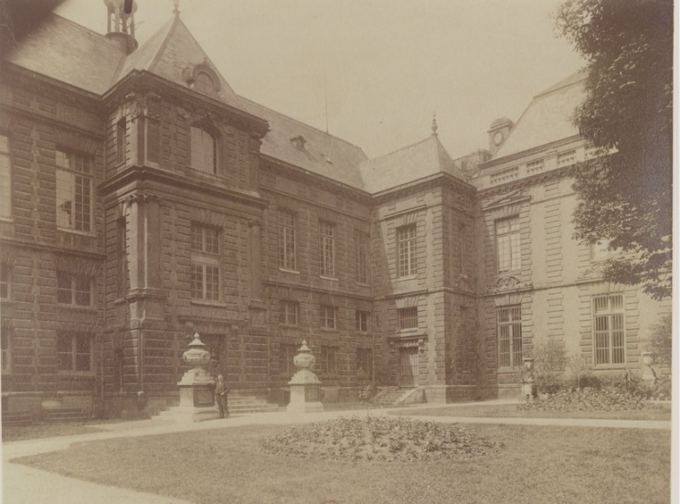
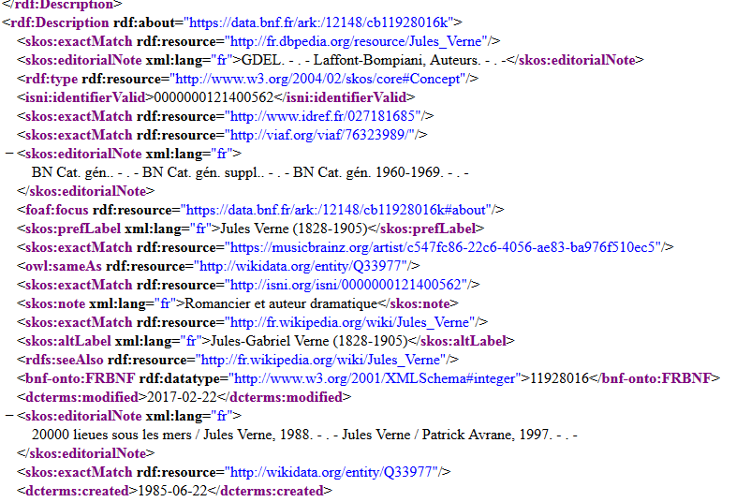
From records to entities
National Library in 1903 / Eugène Atget
ark:/12148/btv1b10516915g
Jules Verne in RDF
https://data.bnf.fr/11928016/jules_verne/rdf.xml
The BnF experience
on structured data
Vincent Boulet

Slide 2

From records to entities
National Library in 1903 / Eugène Atget
ark:/12148/btv1b10516915g
Jules Verne in RDF
https://data.bnf.fr/11928016/jules_verne/rdf.xml
(Some words on) the BnF experience
on structured data
Vincent Boulet

Slide 3

Entities
New approach on data production :
National Entity File
Improving dataflows thanks to identifiers (ISNI)
Semi-automatic creation of new links and new entities (works)
Data dissemination according to FRBR
Authority records
What we concretly have in our catalogues

Slide 4
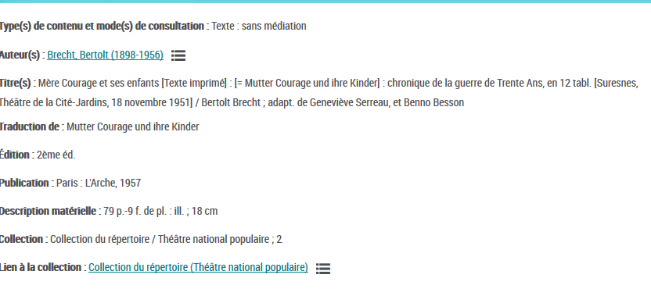
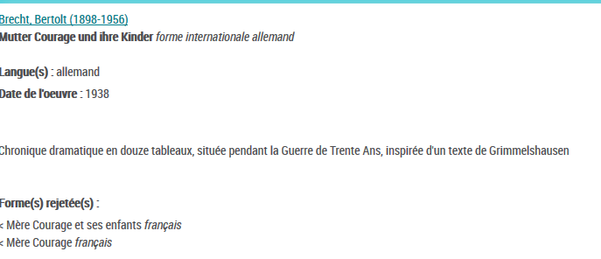
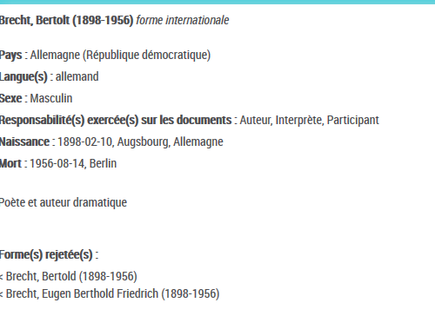
Basing ourselves from
what we have
Bibliographic record
title
ark:/12148/cb39765825t
ark:/12148/cb12434955g
0070
(author)
person
1xx
(creator of)
Links
Persistent identifiers
Codes for roles
ark:/12148/cb11893857f

Slide 5


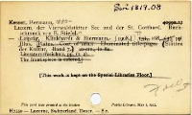
Vintage linked data
Structured data… since 1380
vintage linked data since 1987
Trusted identifiers
Catalogers and catalogue QA team
intelligenT DATA
ConsistencY
link CURATION
https://www.flickr.com/photos/bohman/4394901689
Notes:
Consistence (format, rules)

Slide 6
Entities
New approach on data production
(National Entity File)
Improving dataflows thanks to identifiers (ISNI)
Semi-automatic creation of new links and new entities (works)
Data dissemination according to FRBR
Authority records
What we concretly have in our catalogues

Slide 7

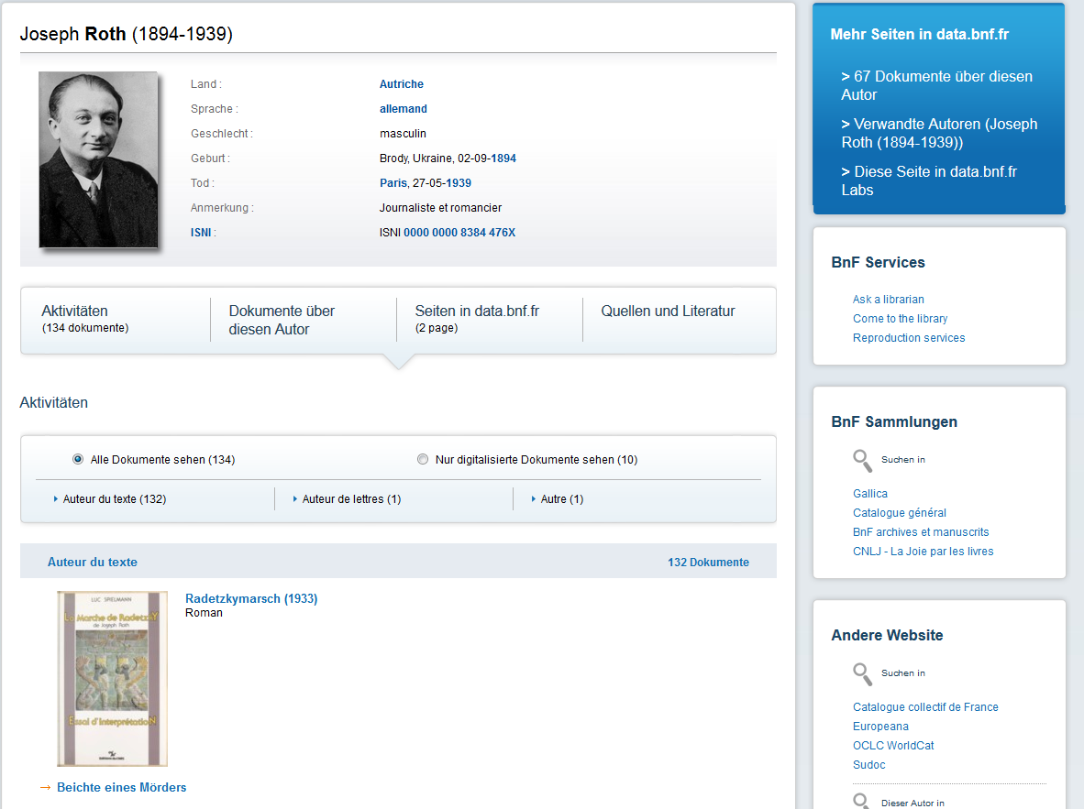
1st step : entities to improve data dissimination and visibility

Slide 8
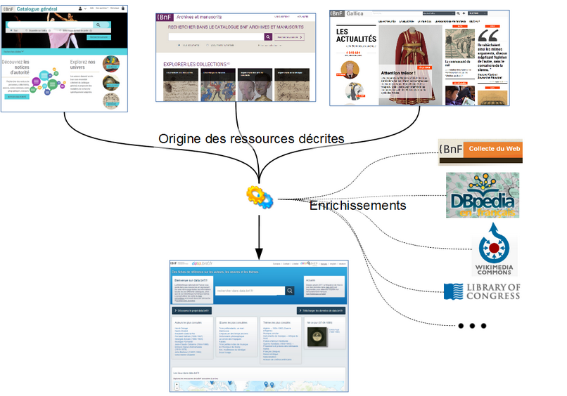

Slide 9
Web pages for humans
Structured data (RDF) for machines

Slide 10
Entities
New approach on data production :
National Entity File
Improving dataflows thanks to identifiers (ISNI)
Semi-automatic creation of new links and new entities (works)
Data dissemination according to FRBR
Authority records
What we concretly have in our catalogues

Slide 11
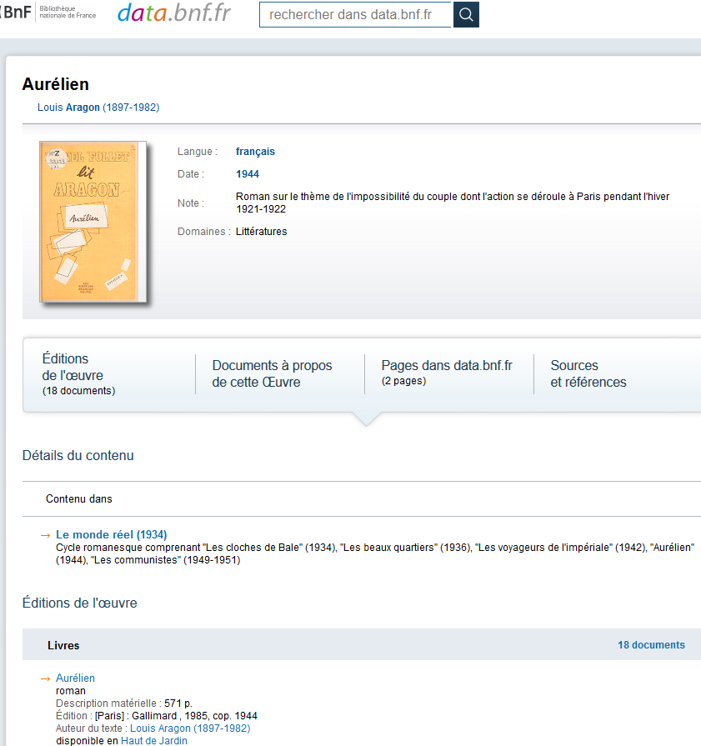
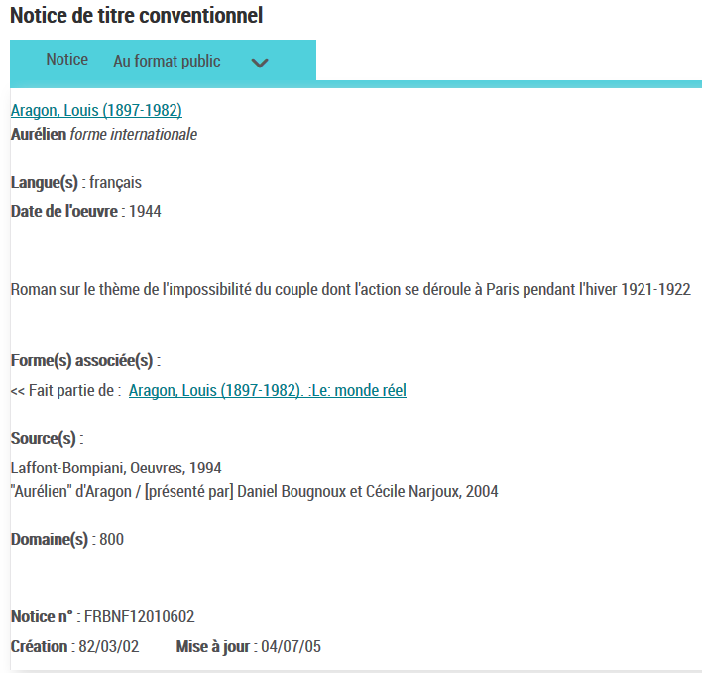
Step 2.1 : Automatic calculation for works
From « uniform titles/bibliographic records » to
« works/manifestation »

Slide 12
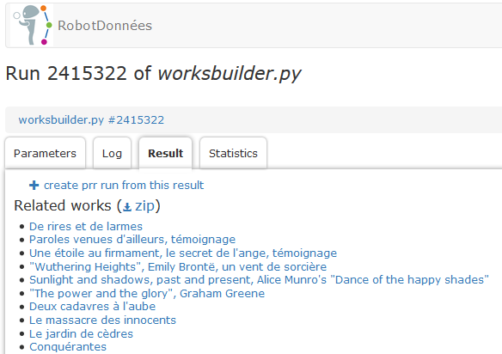
Step 2.2 Automatic calculation for new works
  Ingredients :
    A team of data experts (from Metadata Department)
    A controlled and scalable scope to be tested : French authors from 20th century
      290 000 authority records for authors
      1,1 million of works

Slide 13
Step 2.2 Automatic calculation for new works
  Structured metadata
  from bibliographic records
    Titles
      Title on the manifestation itself
      Original titles
      Other titles
    Authors
    Creation date
    Language
  An aligning tool : « data bot »

Slide 14
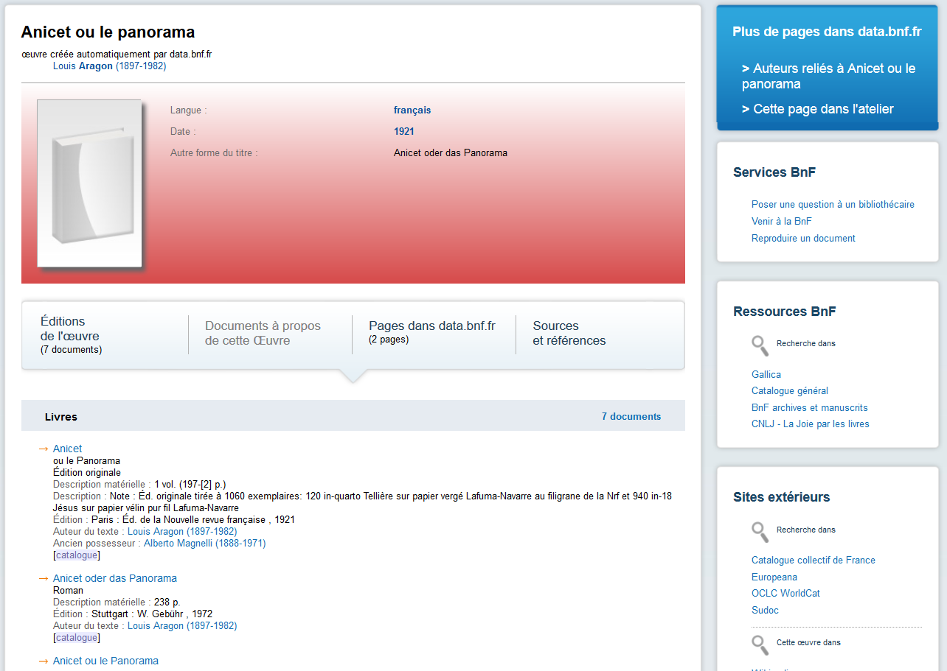
Step 2.2 : analysis of results
Beginning of 2019 : new works will appear in data.bnf.fr
First half of 2019 : tests and analysis
Summer 2019 : retrieval of these works into catalogues

Slide 15
Entities
New approach on data production :
National Entity File
Improving dataflows thanks to identifiers (ISNI)
Semi-automatic creation of new links and new entities (works)
Data dissemination according to FRBR
Authority records
What we concretly have in our catalogues

Slide 16


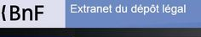


Steps of the “ISNI Request” data flow
Step 4
Request for ISNI / Uploading of Assigned ISNI
into the BnF catalog
Step 1
Legal deposit declaration in ONIX
Step 2
Creation of request forms for contributors without ISNI in the ONIX flow
AtomPub protocol
ISNI
Request
Step 3
Merge with an existing authority record or creation of a new provisional authority record based on ONIX flow
(mapping ONIX>Intermarc)

Slide 17
Steps of the “ISNI Request” data flow
Step 4
Request for ISNI / Uploading of Assigned ISNI
into the BnF catalog
Step 6
Sending ISNIs to publishers
via the Legal Deposit Extranet
AtomPub protocol
ISNI
Request
Step 5
Cataloguing of the book and upgrading of provisional authority record

Slide 18
Entities
New approach on data production :
National Entity File
Improving dataflows thanks to identifiers (ISNI)
Semi-automatic creation of new links and new entities (works)
Data dissemination according to FRBR
Authority records
What we concretly have in our catalogues

Slide 19
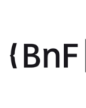

Current national landscape
Public libraries /
Cultural heritage domain
Academic
Libraries : research domain
BnF authority file
One-way dataflow
Higher Education Agency (ABES) authority file
Common challenges : bibliographic transition
national programme

Slide 20

New practices,
New cataloguing rules
Bibliographic transition national programme
News tools

Slide 21
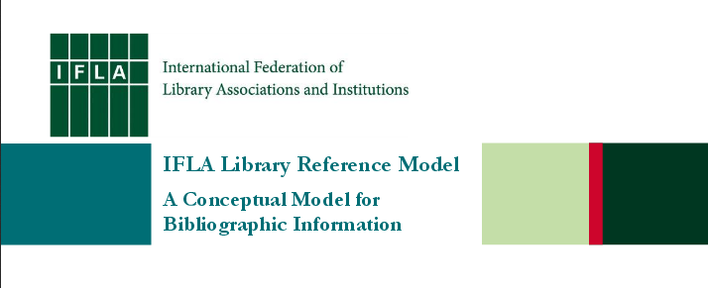


2017
2018/2019 edition

Slide 22
Overview on FNE (as it is imagined today)
One centralized database for production / Based on Wikibase / local interfaces are remaining
Producteurs
Other players
Public libraries
ABES
BnF data production tool
(NOEMI)
Connexion interface with FNE
Direct data production within FNE
Connexion interface with FNE
Direct data production within FNE
Connexion interface with FNE
Direct data production within FNE
Connexion interface with FNE
Direct data production within FNE
Working format
Working format
Working format
Working format
(« Next generation » Intermarc)
BAM
Gallica
Reliures
Presse ancienne
Etc.
Archives, museums…
Public libraries
ABES
ABES
B n F

Slide 23
Overview on FNE (as it is imagined today)
One centralized database for production / Based on Wikibase / local interfaces are remaining
Data production
Data model (in line with LRM conceptual model)
FNE
Working format
Query interface / query API/ import-export
Producteurs
Other players
Public libraries
ABES
BnF data production tool
(NOEMI)
Connexion interface with FNE
Direct data production within FNE
Connexion interface with FNE
Direct data production within FNE
Connexion interface with FNE
Direct data production within FNE
Connexion interface with FNE
Direct data production within FNE
Working format
Working format
Working format
Working format
(« Next generation » Intermarc)
BAM
Gallica
Reliures
Presse ancienne
Etc.
Archives, museums…
Public libraries
ABES
ABES
B n F

Slide 24

Overview on FNE (as it is imagined today)
One centralized database for production / Based on Wikibase / local interfaces are remaining
Technical infrastructure
and tools
WB
Data production
Technical architecture and toolbox
Data model (in line with LRM conceptual model)
Reusing Wikibase as technical infrastructure
FNE
Working format
Query interface / query API/ import-export
Producteurs
Other players
Public libraries
ABES
BnF data production tool
(NOEMI)
Connexion interface with FNE
Direct data production within FNE
Connexion interface with FNE
Direct data production within FNE
Connexion interface with FNE
Direct data production within FNE
Connexion interface with FNE
Direct data production within FNE
Working format
Working format
Working format
Working format
(« Next generation » Intermarc)
BAM
Gallica
Reliures
Presse ancienne
Etc.
Archives, museums…
Public libraries
ABES
ABES
B n F

Slide 25

Development stages
Proof of concept
Governance
Proof of concept
Governance
Business model
Development of FNE
Opening / implementation
Abes
BnF
Other institutions (step by step)
2d half of 2018
2019
2020 - 2022
2023

Slide 26
What does a « proof of concept » based on Wikibase mean :
To what extent Wikibase can be used as technical infrastructure for FNE : How far Wikibase can meet the FNE operational needs?
  Merging BnF-ABES data
  How does it work in a nationalwide co-production environment ?
  Quality control ?
  Data models compatibility ?
  Users’ profiles ?

Slide 27


