Slide 1
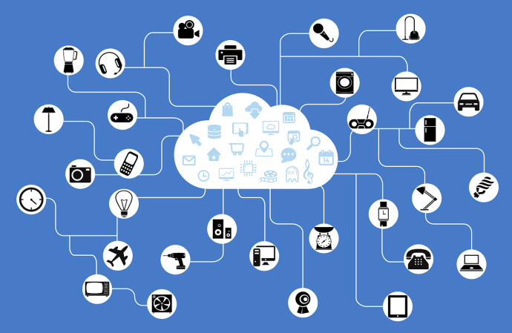
Sweden
– Libris XL
GNDcon 2018-12-03
Harriet Aagaard
National Library of Sweden

Slide 2

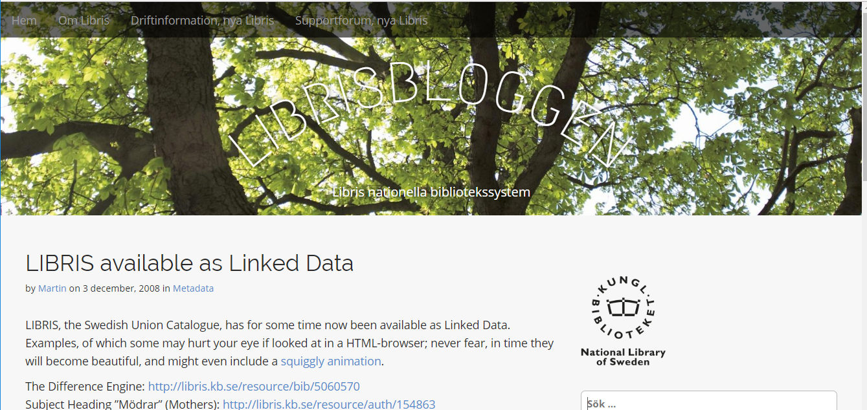
3 December 2008

Slide 3

Linked open data = sharing

Slide 4
Linked open data since 2008
Libris linked data available with open license since 2008
  Limited amount of detail corresponding to Dublin Core level
MARC-records available with CC0 since 2011 for the following subsets:
  National bibliography
  Authorities
    Persons
    Organisations
    Concepts (Swedish Subject Headings based on LCSH)
Aiming for CC0 for both (transformed) MARC21 and JSON-LD

Slide 5

What is Libris?
Libris XL
JSON-LD

Slide 6
What is Libris?
MARC21
Libris XL
JSON-LD
MARC21

Slide 7
Interoperability
Standards
Bibframe
KBV – local application ontology
Plan B – will be cleaned up or discarded
RDA, id.loc.gov
SKOS/MADS
DC
Schema.org
Etc.
Libraries
Everyone

Slide 8
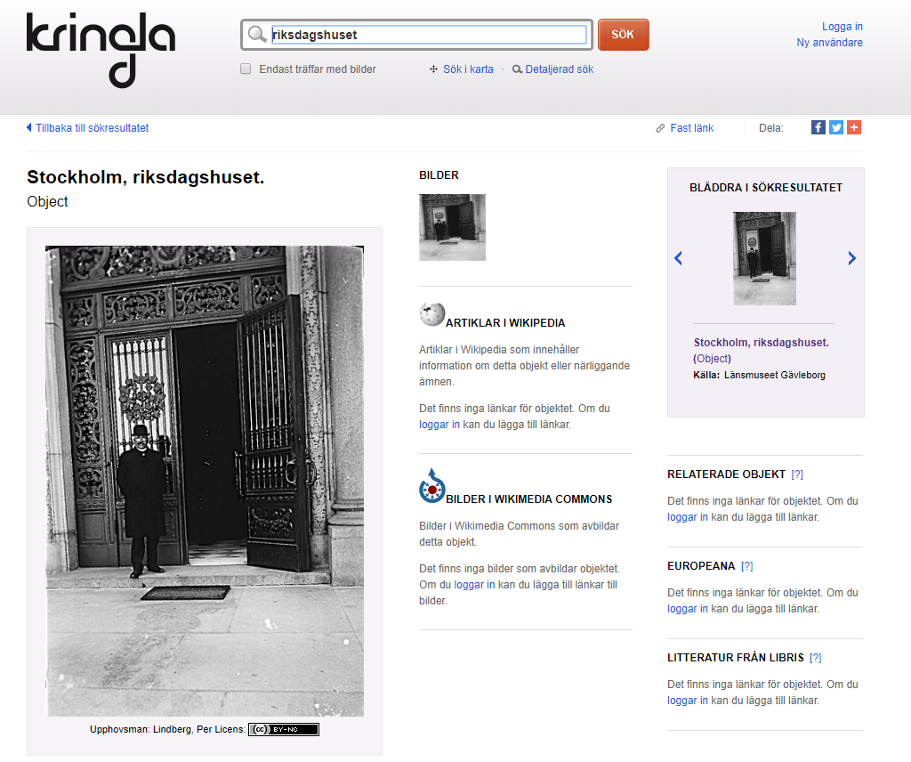
Co-operation with GLAM-sector
Earlier co-operation
Joint hackathons
Different Standards
Links not aggregates
Would be easier with linked data
Sondera (federated search)
Kringla.nu
  Based on K-samsök (aggregated cultural heritage data)
Notes:
Riksantikvarieämbetet - Swedish National Heritage Board

Slide 9

Wikimedia project 2018-2019
To increase use of Swedish library data
Visualize libraries
Cooperation
  Hackathon 14 January 2019

Slide 10
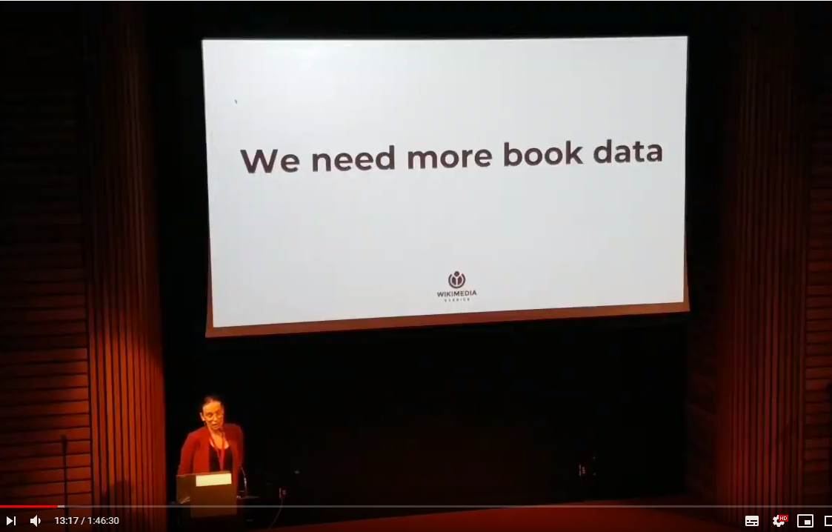
Wikidata
Libris data – easy to use
Linked Open Data
JSON-LD
Bibframe work model
No works
Only the national bibliography
More links
Alicia Fagerwing (Wikimedia Sweden), WikiCite 2018
https://youtu.be/KfF6HNX2u_I

Slide 11
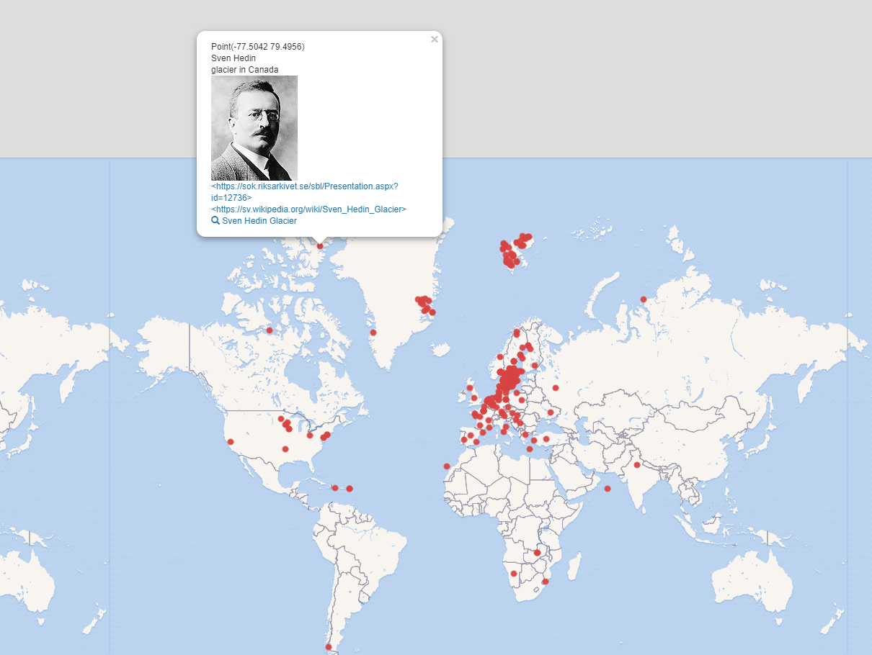
Places named after people - Wikidata
Magnus Sälgö
Wikidata volunteer
Links to Libris
Provenance
Trust important!

Slide 12
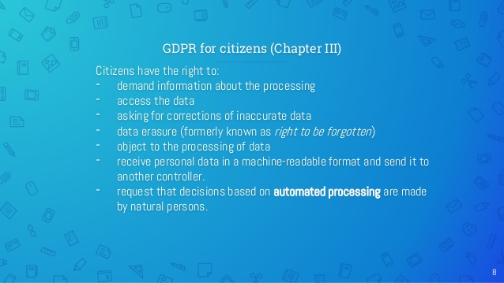
GDPR & Linked data
All data visible
Data erasure?
GDPR & Libraries?
VIAF meeting IFLA 2018
Working group
Presentation by Ricardo Santos

Slide 13
National libraries
Responsible for cultural heritage
Data longevity
Quality important
Provenance
Trust
Do less
to be able to
Do more

Slide 14
Works
RDA
Bibframe
Better services for end users
Less duplication for cataloguers
Work Project December 2018-2019
  Cleanup authors
    ISNI
  Text works (Bibframe)
  Start!
Work
Work
Expression

Slide 15
Consuming Linked data
Our own data
Library LD
Other LD
  Wikidata
Cache vs aggregation
Aggregates is fundamentally
a centralised solution to
a distributed problem
Martin Malmström
National Library of Sweden

Slide 16
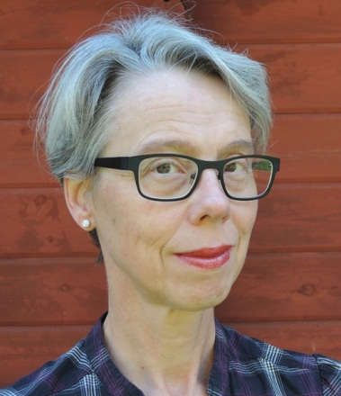
Thank you!
harriet.aagaard@kb.se
@haraag
Linked open data
=
sharing

